Slide 1

Assisting New Scholars
Lakshman Samaranayake
DSc, FRCPath
Dean of Dentistry, University of Hong Kong
King James IV Professor, Royal College of Surgeons of Edinburgh, UK

Slide 2

JICD _ Asia Pacific Focused dental journal

Slide 3
JICD
Frist issue – August 2010
Quarterly publication
One manuscript per day
Rejection rate 80 %

Slide 4

JICD - Demographics
India 35 %
Brazil 22%
Iran 10 %
Europe 10%
China 5%

Slide 5
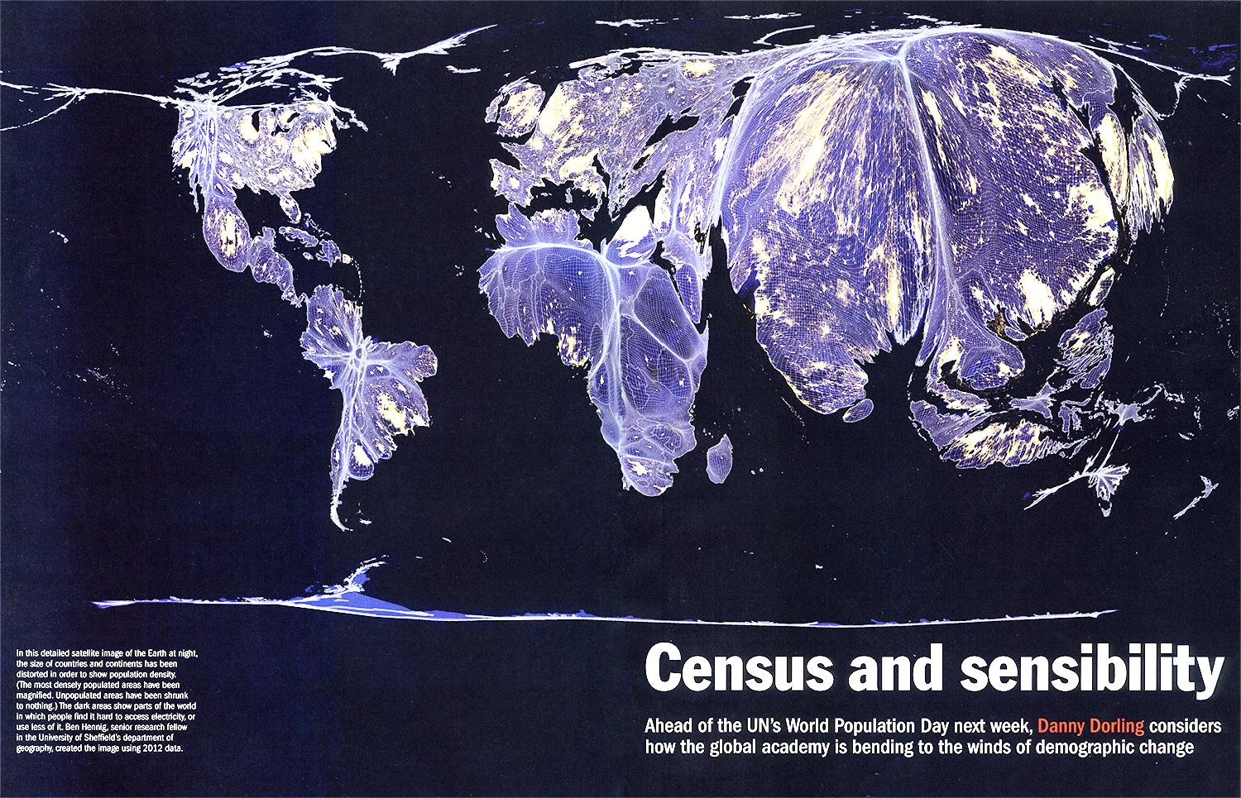

Slide 6
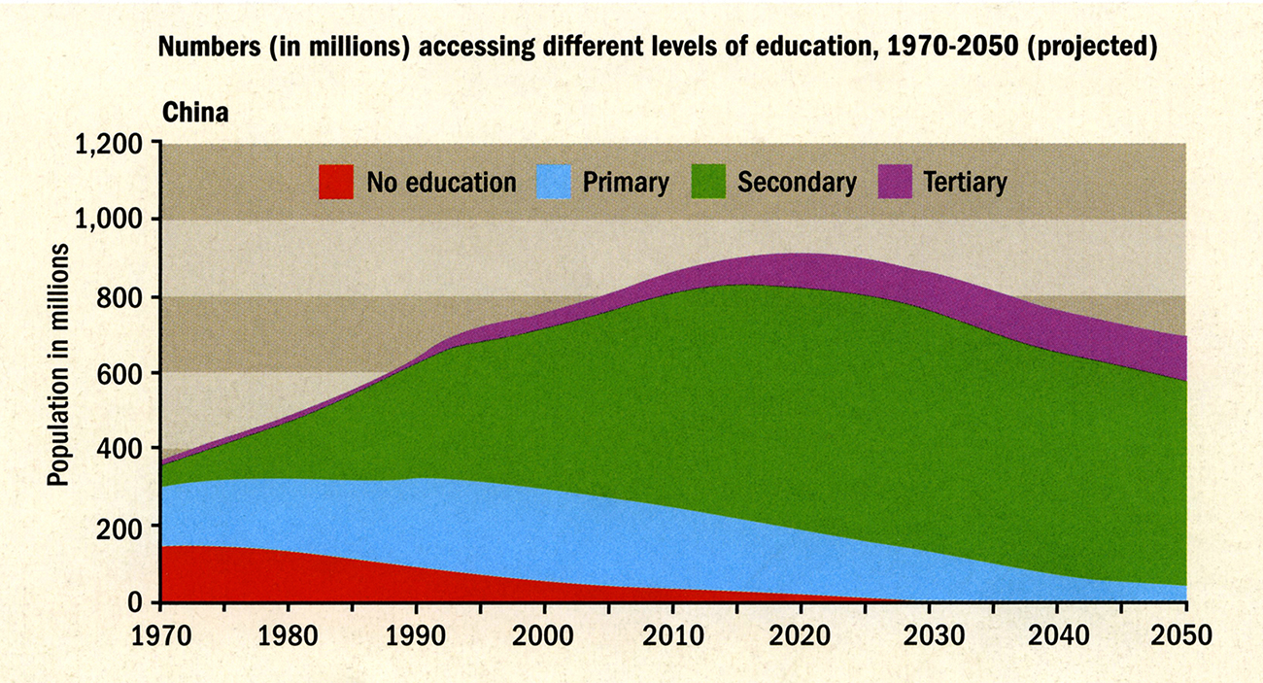

Slide 7
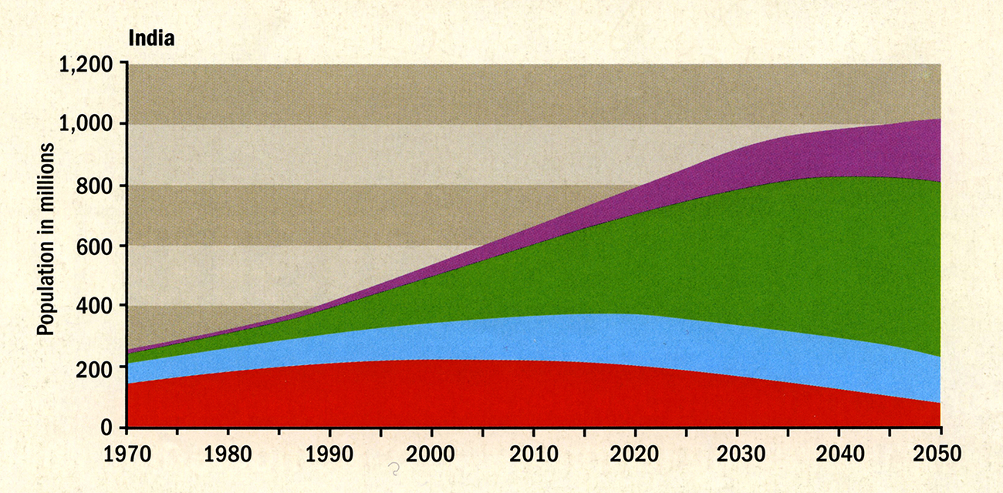

Slide 8
Assisting New Scholars
Common problems:
  Plagiarism
  Self plagiarism
  `Reverse Plagiarism`

Slide 9

Plagiarism
“I am no plagiarist, I only moved a comma”

Slide 10
Plagiarism
In HKU approximately 50 % of disciplinary cases are related to plagiarism and its consequences
Basic ignorance of what plagiarism is
  In one study ` 40% copied word for word without attribution – 90% said that it is plagiarism
  If `some changes` were made to the same text (still without attribution then 40% said no/unsure
Misconceptions about self plagiarism

Slide 11
Data on Plagiarism
One third of UK students think they have plagiarised
65% in Lithuania
46 % France
10% in Germany

Slide 12
Reverse Plagiarism
Purposeful Avoidance of literature in an attempt to deceive the reviewers
Pagiarism
            Samaranayake L P, Nature, 1980

Slide 13
Assisting Scholars
Education
Reorientation
Plagiarismadvice.org

Slide 14
Helping scholars
To help scholars –
We need to understand why papers are rejected

Slide 15

Top 10 Reasons for Rejection
© 2008 Trevor Lane

Slide 16
Top 10 reasons for rejection
Incomplete, inaccurate, outdated or plagirarised literature review
© 2008 Trevor Lane

Slide 17
Top 10 reasons for rejection
Incomplete, inaccurate, outdated or plagiarised literature review:
Need to recognize that a literature review should be contextual, concise complete and free-of plagiarized material
© 2008 Trevor Lane

Slide 18
Top 10 reasons for rejection
Sample too small or biased
© 2008 Trevor Lane

Slide 19
Top 10 reasons for rejection
Sample too small or biased
Commonest reason for rejection
Not understanding the importance
of power analysis
© 2008 Trevor Lane

Slide 20
Top 10 reasons for rejection
Inaccurate or inconsistent data
© 2008 Trevor Lane

Slide 21
Top 10 reasons for rejection
Inaccurate or inconsistent data
Assist by:
training the scholars and teachers
Poor manuscript = sloppy experimental work
© 2008 Trevor Lane

Slide 22
Top 10 reasons for rejection
Insufficient data presented
© 2008 Trevor Lane

Slide 23
Top 10 reasons for rejection
Insufficient data presented:
Commonest mistake!
Assist by:
Not to be splitters but lumpers
© 2008 Trevor Lane

Slide 24
Writing skills!
Poor organisation
Too long and verbose
Failure to communicate clearly
Poor grammar, syntax, spelling
Excessively self-promotional
Poorly written abstract

Slide 25
Top 10 reasons for rejection
Mentoring the mentors
Scientific editing
© 2008 Trevor Lane

Slide 26
Top 10 reasons for rejection
Inappropriate or suboptimal instrumentation
Inappropriate of incomplete statistics
© 2008 Trevor Lane

Slide 27
How should we help?
Education
Workshops
University emphasis on research ethics and consequences
  Research integrity office/r
Data Privacy issues
Authorship issues
  Who owns the data?

Slide 28

Thank you!
www.facdenthk.org

