Slide 1
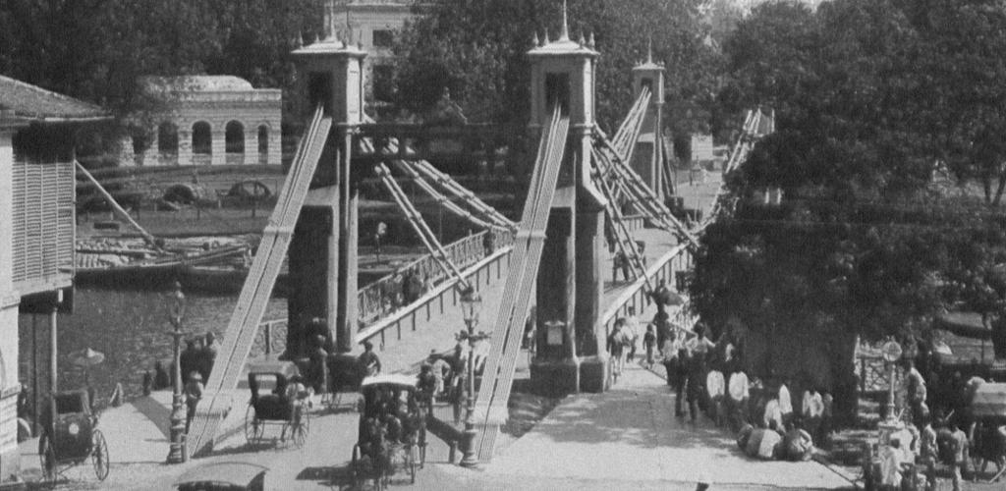
The Built Works Registry and the Infrastructure to Support it
James Shulman

Slide 2
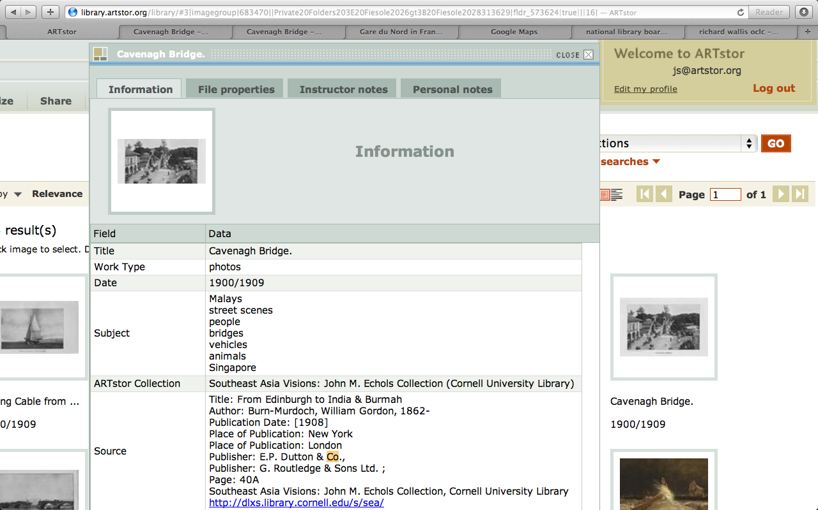

Slide 3
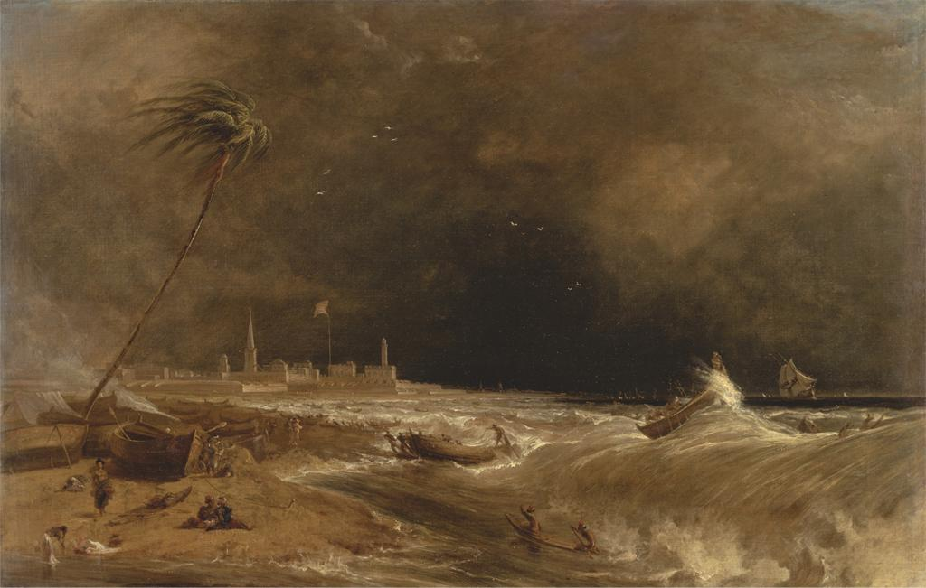
Notes:
Creator: William Daniell, 1769-1837, British
Title: Madras, or Fort St. George, in the Bay of Bengal -- A Squall Passing Off
Title: Approaching Storm, Madras
Work Type: Painting
Work Type: landscape; marine art
Date: 1833
Material: Oil on canvas
Measurements: 27 x 42 inches (68.6 x 106.7 cm)
Description: No inscription
Description: Signed and dated, lower left: "W. D. 1833."
Repository: Yale Center for British Art, Paul Mellon Collection
Accession Number: B1981.25.209
Related Item: Pauline Rohatgi, Indian life and landscape by Western artists, paintings and drawings from the Victoria and Albert Museum, 17th to the early 20th century, Chhatrapati Shivaji Maharaj Vastu Sangrahalaya, Mumbai, 2008, pp. 245-49, fig. 2, N8214.5 I5 V53 2008 + (YCBA); Morna O'Neill, Company culture, British artists and the East India Company 1770-1830 : October 16, 2003-January 11, 2004., Yale Center for British Art, New Haven, 2003, no. 25, V 1199 (YCBA); Mary Webster, Johan Zoffany, 1733-1810, Yale University Press, New Haven [Conn.], 2011, p. 451, fig. 338, NJ18 Z68 W43 2011 + (YCBA); Painting in England 1700-1850 from the Collection of Mr. and Mrs. Paul Mellon, The Royal Academy of Arts Winter Exhibition 1964-65., Royal Academy of Arts, London, UK, 1964, p. 49 (v.1), no. 179, ND466 R68 1964/65 (YCBA) , V. 2 is only available on MICROFICHE; See Fiche B214; Virginia Museum of Fine Arts, Painting in England 1700-1850, collection of Mr. & Mrs. Paul Mellon., Richmond, VA, 1963, p. 96 (v.1), no. 150, pl. 68, ND466 V57 v.1-2 (YCBA); Yale University Art Gallery, Painting in England, 1700-1850, from the collection of Mr. and Mrs. Paul Mellon, [exhibition at] Yale University Art Gallery, April 15-June 20, 1965., vol. 1, W. Clowes and sons, , 1965, p. 20 (v.1), no. 69, ND466 Y35 (YCBA); Catalogue of English pictures and drawings, Christie's, June 24, 1960, p. 26, no. 118, Sales Catalogue (YCBA)
Related Item: http://collections.britishart.yale.edu/vufind/Record/1670837
Subject: Orientalism; wind; people; storm; waves; steeple; ocean; sea; shore (landform); tree; beach; lighthouse; boats; landscape; marines (visual works); church; fort; flag; Union Jack
Collection: Yale Center for British Art
Collection: http://britishart.yale.edu
ID Number: 719
Source: Yale Center for British Art
Rights:
Rights: The Yale Center for British Art makes its photographic images of works believed to be in the public domain or with no known restrictions freely available. Please review the Center's image use terms here:
Rights: http://britishart.yale.edu/collections/using-collections/image-use
Rights: ARTstor does not seek to restrict the use of this image beyond the Center's terms; however, should there be any third-party copyrights in this image, and should you use this image beyond the ARTstor terms of use, you are solely responsible for any necessary third-party copyright clearances.

Slide 4
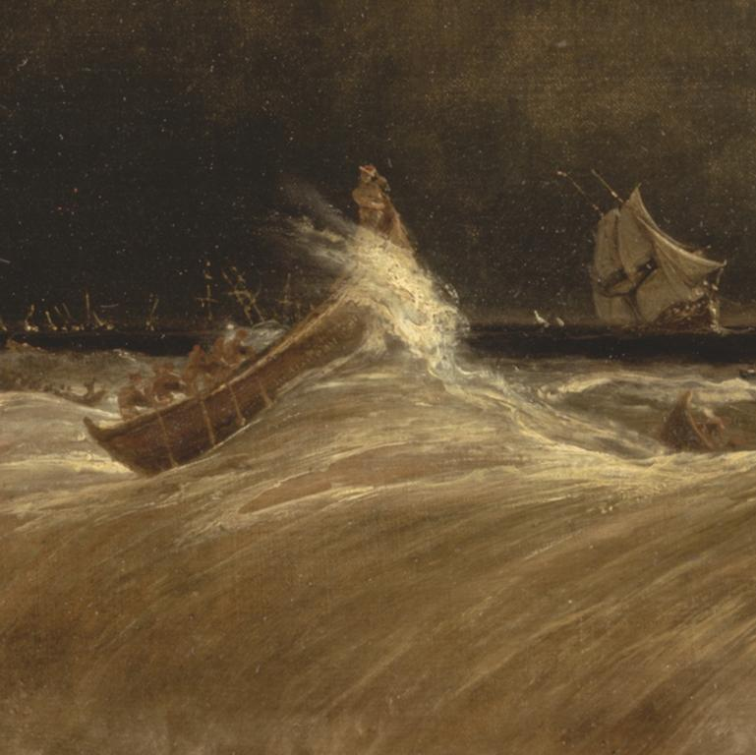
Notes:
Creator: William Daniell, 1769-1837, British
Title: Madras, or Fort St. George, in the Bay of Bengal -- A Squall Passing Off
Title: Approaching Storm, Madras
Work Type: Painting
Work Type: landscape; marine art
Date: 1833
Material: Oil on canvas
Measurements: 27 x 42 inches (68.6 x 106.7 cm)
Description: No inscription
Description: Signed and dated, lower left: "W. D. 1833."
Repository: Yale Center for British Art, Paul Mellon Collection
Accession Number: B1981.25.209
Related Item: Pauline Rohatgi, Indian life and landscape by Western artists, paintings and drawings from the Victoria and Albert Museum, 17th to the early 20th century, Chhatrapati Shivaji Maharaj Vastu Sangrahalaya, Mumbai, 2008, pp. 245-49, fig. 2, N8214.5 I5 V53 2008 + (YCBA); Morna O'Neill, Company culture, British artists and the East India Company 1770-1830 : October 16, 2003-January 11, 2004., Yale Center for British Art, New Haven, 2003, no. 25, V 1199 (YCBA); Mary Webster, Johan Zoffany, 1733-1810, Yale University Press, New Haven [Conn.], 2011, p. 451, fig. 338, NJ18 Z68 W43 2011 + (YCBA); Painting in England 1700-1850 from the Collection of Mr. and Mrs. Paul Mellon, The Royal Academy of Arts Winter Exhibition 1964-65., Royal Academy of Arts, London, UK, 1964, p. 49 (v.1), no. 179, ND466 R68 1964/65 (YCBA) , V. 2 is only available on MICROFICHE; See Fiche B214; Virginia Museum of Fine Arts, Painting in England 1700-1850, collection of Mr. & Mrs. Paul Mellon., Richmond, VA, 1963, p. 96 (v.1), no. 150, pl. 68, ND466 V57 v.1-2 (YCBA); Yale University Art Gallery, Painting in England, 1700-1850, from the collection of Mr. and Mrs. Paul Mellon, [exhibition at] Yale University Art Gallery, April 15-June 20, 1965., vol. 1, W. Clowes and sons, , 1965, p. 20 (v.1), no. 69, ND466 Y35 (YCBA); Catalogue of English pictures and drawings, Christie's, June 24, 1960, p. 26, no. 118, Sales Catalogue (YCBA)
Related Item: http://collections.britishart.yale.edu/vufind/Record/1670837
Subject: Orientalism; wind; people; storm; waves; steeple; ocean; sea; shore (landform); tree; beach; lighthouse; boats; landscape; marines (visual works); church; fort; flag; Union Jack
Collection: Yale Center for British Art
Collection: http://britishart.yale.edu
ID Number: 719
Source: Yale Center for British Art
Rights:
Rights: The Yale Center for British Art makes its photographic images of works believed to be in the public domain or with no known restrictions freely available. Please review the Center's image use terms here:
Rights: http://britishart.yale.edu/collections/using-collections/image-use
Rights: ARTstor does not seek to restrict the use of this image beyond the Center's terms; however, should there be any third-party copyrights in this image, and should you use this image beyond the ARTstor terms of use, you are solely responsible for any necessary third-party copyright clearances.

Slide 5
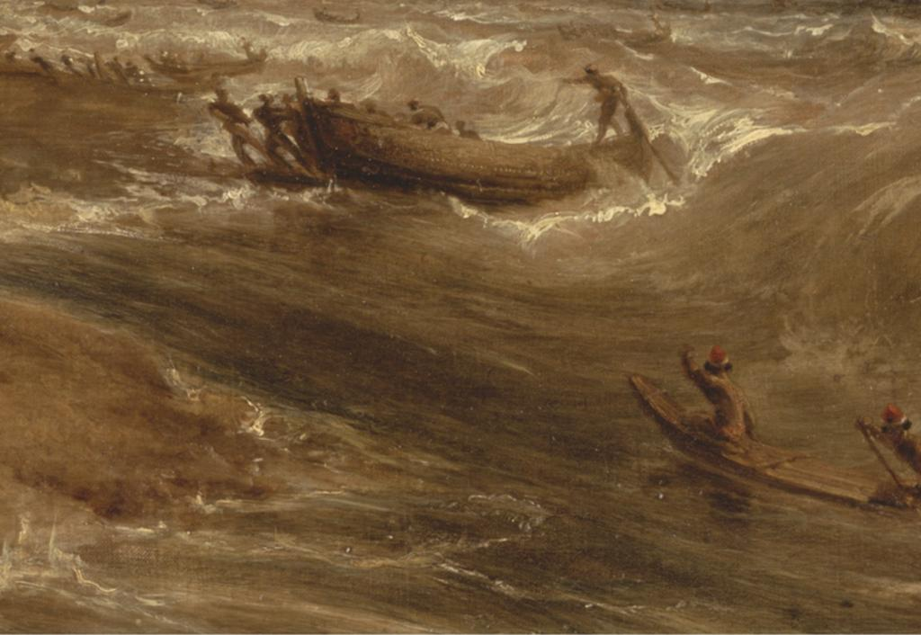
Notes:
Creator: William Daniell, 1769-1837, British
Title: Madras, or Fort St. George, in the Bay of Bengal -- A Squall Passing Off
Title: Approaching Storm, Madras
Work Type: Painting
Work Type: landscape; marine art
Date: 1833
Material: Oil on canvas
Measurements: 27 x 42 inches (68.6 x 106.7 cm)
Description: No inscription
Description: Signed and dated, lower left: "W. D. 1833."
Repository: Yale Center for British Art, Paul Mellon Collection
Accession Number: B1981.25.209
Related Item: Pauline Rohatgi, Indian life and landscape by Western artists, paintings and drawings from the Victoria and Albert Museum, 17th to the early 20th century, Chhatrapati Shivaji Maharaj Vastu Sangrahalaya, Mumbai, 2008, pp. 245-49, fig. 2, N8214.5 I5 V53 2008 + (YCBA); Morna O'Neill, Company culture, British artists and the East India Company 1770-1830 : October 16, 2003-January 11, 2004., Yale Center for British Art, New Haven, 2003, no. 25, V 1199 (YCBA); Mary Webster, Johan Zoffany, 1733-1810, Yale University Press, New Haven [Conn.], 2011, p. 451, fig. 338, NJ18 Z68 W43 2011 + (YCBA); Painting in England 1700-1850 from the Collection of Mr. and Mrs. Paul Mellon, The Royal Academy of Arts Winter Exhibition 1964-65., Royal Academy of Arts, London, UK, 1964, p. 49 (v.1), no. 179, ND466 R68 1964/65 (YCBA) , V. 2 is only available on MICROFICHE; See Fiche B214; Virginia Museum of Fine Arts, Painting in England 1700-1850, collection of Mr. & Mrs. Paul Mellon., Richmond, VA, 1963, p. 96 (v.1), no. 150, pl. 68, ND466 V57 v.1-2 (YCBA); Yale University Art Gallery, Painting in England, 1700-1850, from the collection of Mr. and Mrs. Paul Mellon, [exhibition at] Yale University Art Gallery, April 15-June 20, 1965., vol. 1, W. Clowes and sons, , 1965, p. 20 (v.1), no. 69, ND466 Y35 (YCBA); Catalogue of English pictures and drawings, Christie's, June 24, 1960, p. 26, no. 118, Sales Catalogue (YCBA)
Related Item: http://collections.britishart.yale.edu/vufind/Record/1670837
Subject: Orientalism; wind; people; storm; waves; steeple; ocean; sea; shore (landform); tree; beach; lighthouse; boats; landscape; marines (visual works); church; fort; flag; Union Jack
Collection: Yale Center for British Art
Collection: http://britishart.yale.edu
ID Number: 719
Source: Yale Center for British Art
Rights:
Rights: The Yale Center for British Art makes its photographic images of works believed to be in the public domain or with no known restrictions freely available. Please review the Center's image use terms here:
Rights: http://britishart.yale.edu/collections/using-collections/image-use
Rights: ARTstor does not seek to restrict the use of this image beyond the Center's terms; however, should there be any third-party copyrights in this image, and should you use this image beyond the ARTstor terms of use, you are solely responsible for any necessary third-party copyright clearances.

Slide 6
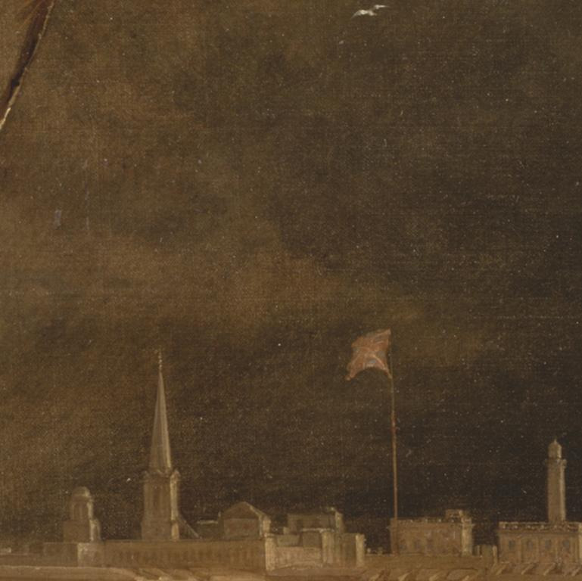
Notes:
Creator: William Daniell, 1769-1837, British
Title: Madras, or Fort St. George, in the Bay of Bengal -- A Squall Passing Off
Title: Approaching Storm, Madras
Work Type: Painting
Work Type: landscape; marine art
Date: 1833
Material: Oil on canvas
Measurements: 27 x 42 inches (68.6 x 106.7 cm)
Description: No inscription
Description: Signed and dated, lower left: "W. D. 1833."
Repository: Yale Center for British Art, Paul Mellon Collection
Accession Number: B1981.25.209
Related Item: Pauline Rohatgi, Indian life and landscape by Western artists, paintings and drawings from the Victoria and Albert Museum, 17th to the early 20th century, Chhatrapati Shivaji Maharaj Vastu Sangrahalaya, Mumbai, 2008, pp. 245-49, fig. 2, N8214.5 I5 V53 2008 + (YCBA); Morna O'Neill, Company culture, British artists and the East India Company 1770-1830 : October 16, 2003-January 11, 2004., Yale Center for British Art, New Haven, 2003, no. 25, V 1199 (YCBA); Mary Webster, Johan Zoffany, 1733-1810, Yale University Press, New Haven [Conn.], 2011, p. 451, fig. 338, NJ18 Z68 W43 2011 + (YCBA); Painting in England 1700-1850 from the Collection of Mr. and Mrs. Paul Mellon, The Royal Academy of Arts Winter Exhibition 1964-65., Royal Academy of Arts, London, UK, 1964, p. 49 (v.1), no. 179, ND466 R68 1964/65 (YCBA) , V. 2 is only available on MICROFICHE; See Fiche B214; Virginia Museum of Fine Arts, Painting in England 1700-1850, collection of Mr. & Mrs. Paul Mellon., Richmond, VA, 1963, p. 96 (v.1), no. 150, pl. 68, ND466 V57 v.1-2 (YCBA); Yale University Art Gallery, Painting in England, 1700-1850, from the collection of Mr. and Mrs. Paul Mellon, [exhibition at] Yale University Art Gallery, April 15-June 20, 1965., vol. 1, W. Clowes and sons, , 1965, p. 20 (v.1), no. 69, ND466 Y35 (YCBA); Catalogue of English pictures and drawings, Christie's, June 24, 1960, p. 26, no. 118, Sales Catalogue (YCBA)
Related Item: http://collections.britishart.yale.edu/vufind/Record/1670837
Subject: Orientalism; wind; people; storm; waves; steeple; ocean; sea; shore (landform); tree; beach; lighthouse; boats; landscape; marines (visual works); church; fort; flag; Union Jack
Collection: Yale Center for British Art
Collection: http://britishart.yale.edu
ID Number: 719
Source: Yale Center for British Art
Rights:
Rights: The Yale Center for British Art makes its photographic images of works believed to be in the public domain or with no known restrictions freely available. Please review the Center's image use terms here:
Rights: http://britishart.yale.edu/collections/using-collections/image-use
Rights: ARTstor does not seek to restrict the use of this image beyond the Center's terms; however, should there be any third-party copyrights in this image, and should you use this image beyond the ARTstor terms of use, you are solely responsible for any necessary third-party copyright clearances.

Slide 7
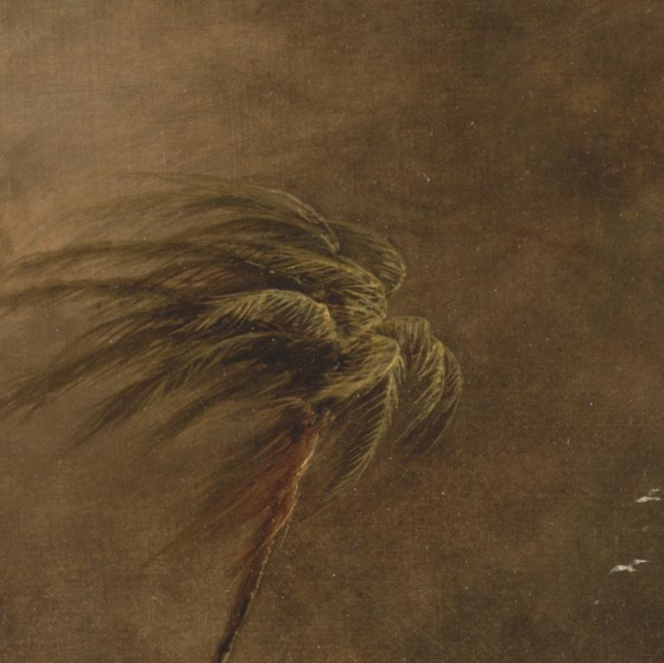
Notes:
Creator: William Daniell, 1769-1837, British
Title: Madras, or Fort St. George, in the Bay of Bengal -- A Squall Passing Off
Title: Approaching Storm, Madras
Work Type: Painting
Work Type: landscape; marine art
Date: 1833
Material: Oil on canvas
Measurements: 27 x 42 inches (68.6 x 106.7 cm)
Description: No inscription
Description: Signed and dated, lower left: "W. D. 1833."
Repository: Yale Center for British Art, Paul Mellon Collection
Accession Number: B1981.25.209
Related Item: Pauline Rohatgi, Indian life and landscape by Western artists, paintings and drawings from the Victoria and Albert Museum, 17th to the early 20th century, Chhatrapati Shivaji Maharaj Vastu Sangrahalaya, Mumbai, 2008, pp. 245-49, fig. 2, N8214.5 I5 V53 2008 + (YCBA); Morna O'Neill, Company culture, British artists and the East India Company 1770-1830 : October 16, 2003-January 11, 2004., Yale Center for British Art, New Haven, 2003, no. 25, V 1199 (YCBA); Mary Webster, Johan Zoffany, 1733-1810, Yale University Press, New Haven [Conn.], 2011, p. 451, fig. 338, NJ18 Z68 W43 2011 + (YCBA); Painting in England 1700-1850 from the Collection of Mr. and Mrs. Paul Mellon, The Royal Academy of Arts Winter Exhibition 1964-65., Royal Academy of Arts, London, UK, 1964, p. 49 (v.1), no. 179, ND466 R68 1964/65 (YCBA) , V. 2 is only available on MICROFICHE; See Fiche B214; Virginia Museum of Fine Arts, Painting in England 1700-1850, collection of Mr. & Mrs. Paul Mellon., Richmond, VA, 1963, p. 96 (v.1), no. 150, pl. 68, ND466 V57 v.1-2 (YCBA); Yale University Art Gallery, Painting in England, 1700-1850, from the collection of Mr. and Mrs. Paul Mellon, [exhibition at] Yale University Art Gallery, April 15-June 20, 1965., vol. 1, W. Clowes and sons, , 1965, p. 20 (v.1), no. 69, ND466 Y35 (YCBA); Catalogue of English pictures and drawings, Christie's, June 24, 1960, p. 26, no. 118, Sales Catalogue (YCBA)
Related Item: http://collections.britishart.yale.edu/vufind/Record/1670837
Subject: Orientalism; wind; people; storm; waves; steeple; ocean; sea; shore (landform); tree; beach; lighthouse; boats; landscape; marines (visual works); church; fort; flag; Union Jack
Collection: Yale Center for British Art
Collection: http://britishart.yale.edu
ID Number: 719
Source: Yale Center for British Art
Rights:
Rights: The Yale Center for British Art makes its photographic images of works believed to be in the public domain or with no known restrictions freely available. Please review the Center's image use terms here:
Rights: http://britishart.yale.edu/collections/using-collections/image-use
Rights: ARTstor does not seek to restrict the use of this image beyond the Center's terms; however, should there be any third-party copyrights in this image, and should you use this image beyond the ARTstor terms of use, you are solely responsible for any necessary third-party copyright clearances.

Slide 8
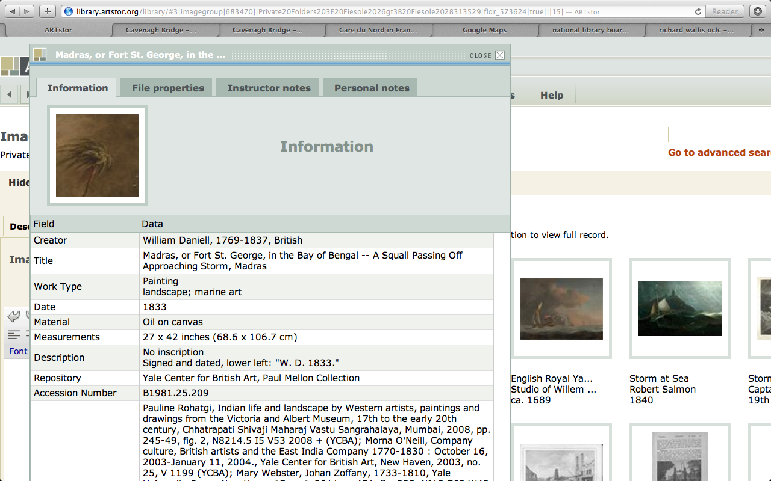

Slide 9
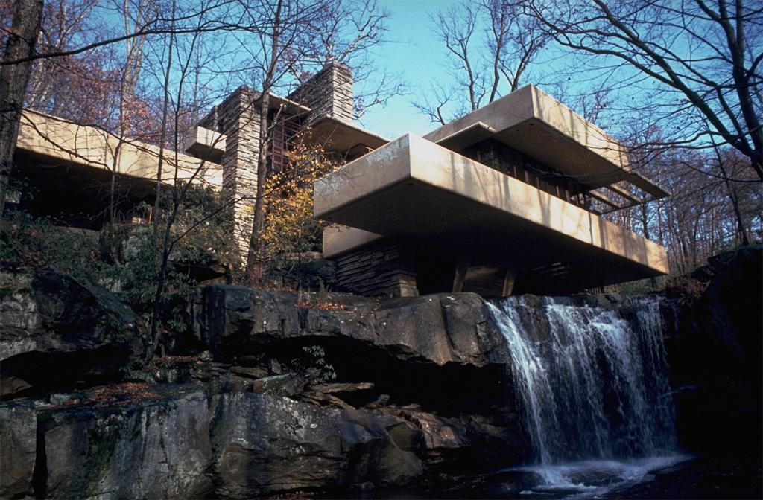
Sample problem:
Core data
  Falling Water or Fallingwater
  Kaufmann or Kauffman House
  Edgar J. Kaufmann Sr. Residence or Kaufmann Desert House
  Frank Lloyd Wright or Richard Neutra ?
  Mill Run or Bear Run?
Enhanced data
  Geo-code
  Dates
  View
  Type

Slide 10
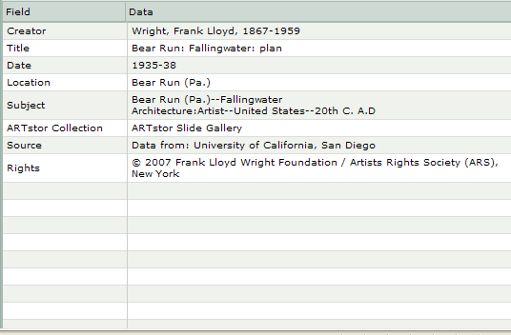
Sample data

Slide 11
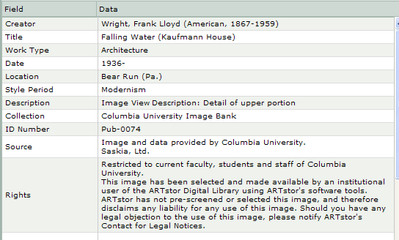
Sample data

Slide 12
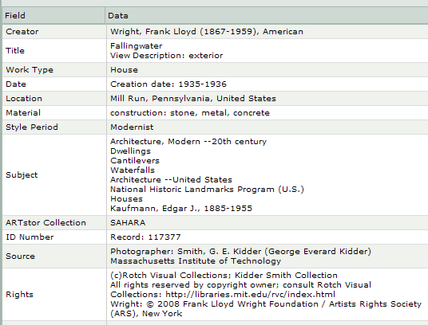
Sample data

Slide 13
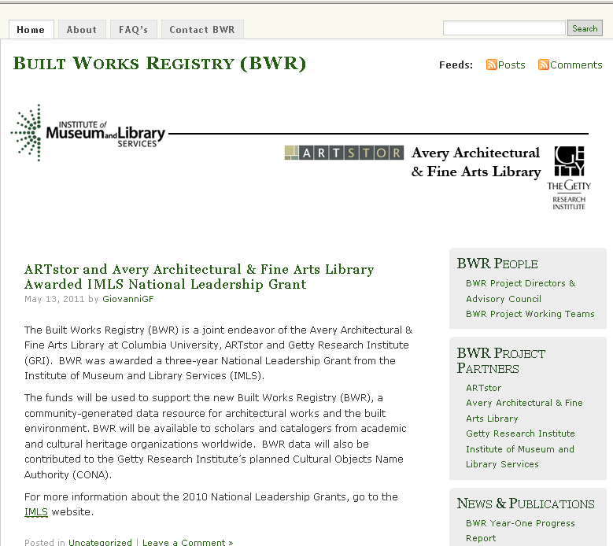
http://builtworksregistry.wordpress.com/

Slide 14



BWR partnership
“New partnerships will result from collaboration and coordination among a wide array of stakeholders. This will realize workflow efficiencies and minimize redundancies between and among entities that create and use both authority and bibliographic data…”
Report of the LC Working Group on the Future of Bibliographic Control (2008)

Slide 15
BWR project goals
Construct a registry for architectural works and the built environment
Develop unique IDs & trusted data records for registered works
Reduce redundancy by providing a networked source of authoritative data
Develop a collaborative community plan to seed, build upon and edit a shared record

Slide 16
Policies
Project partners +
BWR Advisory Council
  Canada, Germany, India, Italy, Japan, Taiwan, Turkey, UK, US
18 scholars, curators, librarians, & technologists representing diverse specializations in academic & cultural institutions:
  Museums: MoMA, AIC, Smithsonian, National Palace Museum Taipei
  Libraries: Columbia, Cornell, Harvard, Yale, NYU, Colby, UMiami, Illinois
  Research institutes: Courtauld, Max Planck, Inst. For Museum Research
  Organizations: RIBA, World Monuments Fund, SAH, IFLA
Notes:
Founders Agreement
Joint ownership of BWR records
Establishes BWR standing committee
Succession plan
Contributor Agreements
Institutional contributions
Individual contributors

Slide 17
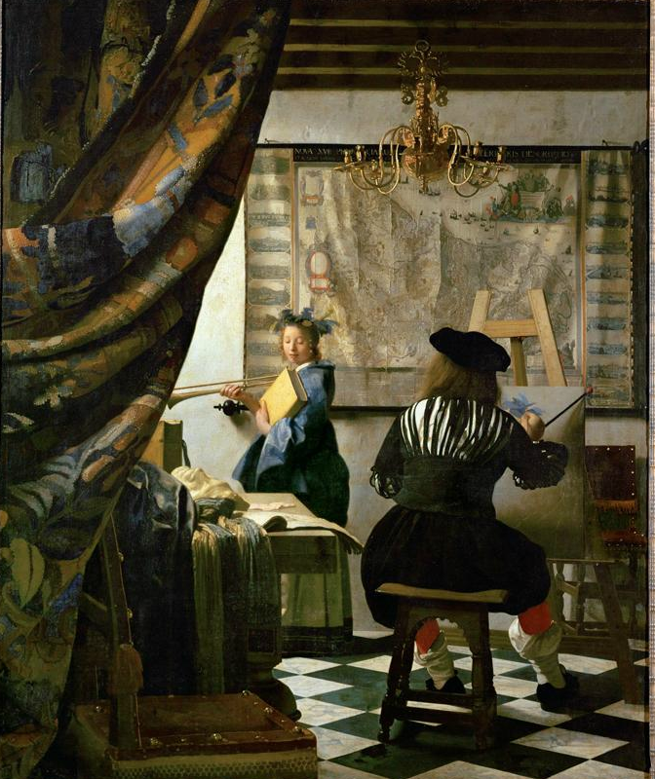
  ARTstor Digital Library Today
  Founded by The Andrew W. Mellon Foundation in 2001
  Independent nonprofit organization since 2003
  Launched in July 1, 2004
  1.6 million images and growing
  200+ museum & special collections
  Museums, archives, libraries, artists, artists’ estates, scholars, photographers
  Password-protected database restricted to educational and scholarly users
Notes:
Jan VermeerTitleThe Painter and his Model as KlioDate1665-1666Materialoil on canvasMeasurements120 x 100 cmRepositoryKunsthistorisches Museum ViennaARTstor CollectionArt, Archaeology and Architecture (Erich Lessing Culture and Fine Arts Archives)ID Number40-03-01/50SourceImage and original data provided by Erich Lessing Culture and Fine Arts Archives/ART RESOURCE, N.Y.
http://www.artres.com/c/htm/Home.aspx
http://www.artres.com/c/htm/TreePfLight.aspx?ID=LES

Slide 18
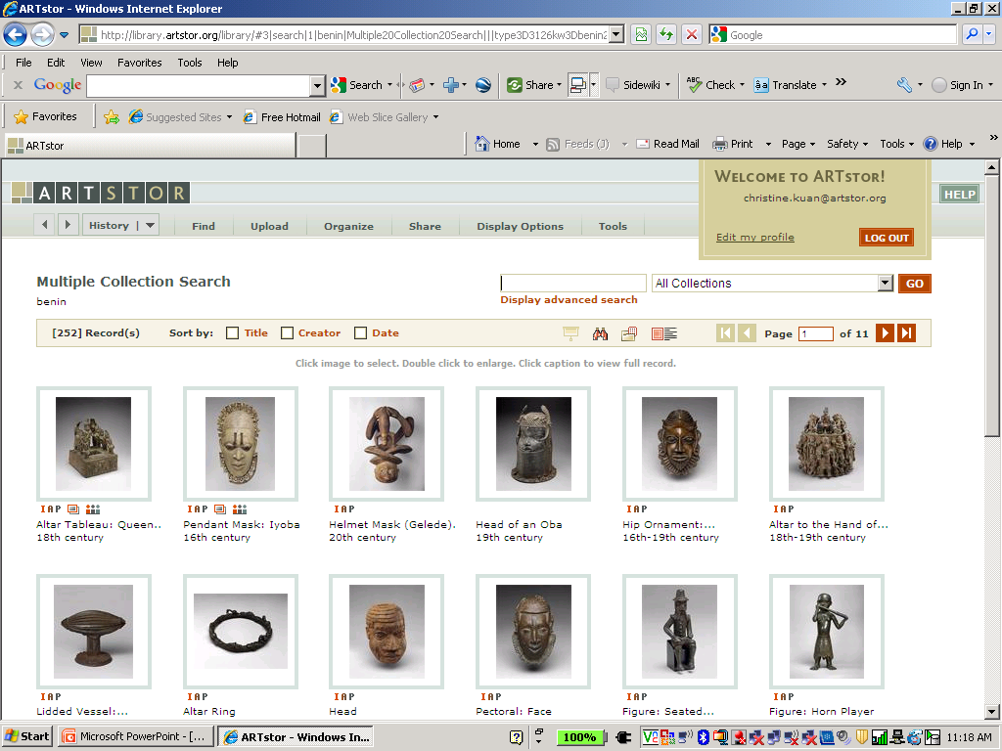

Associated images – What are instructors teaching?
Associated
Images

Slide 19
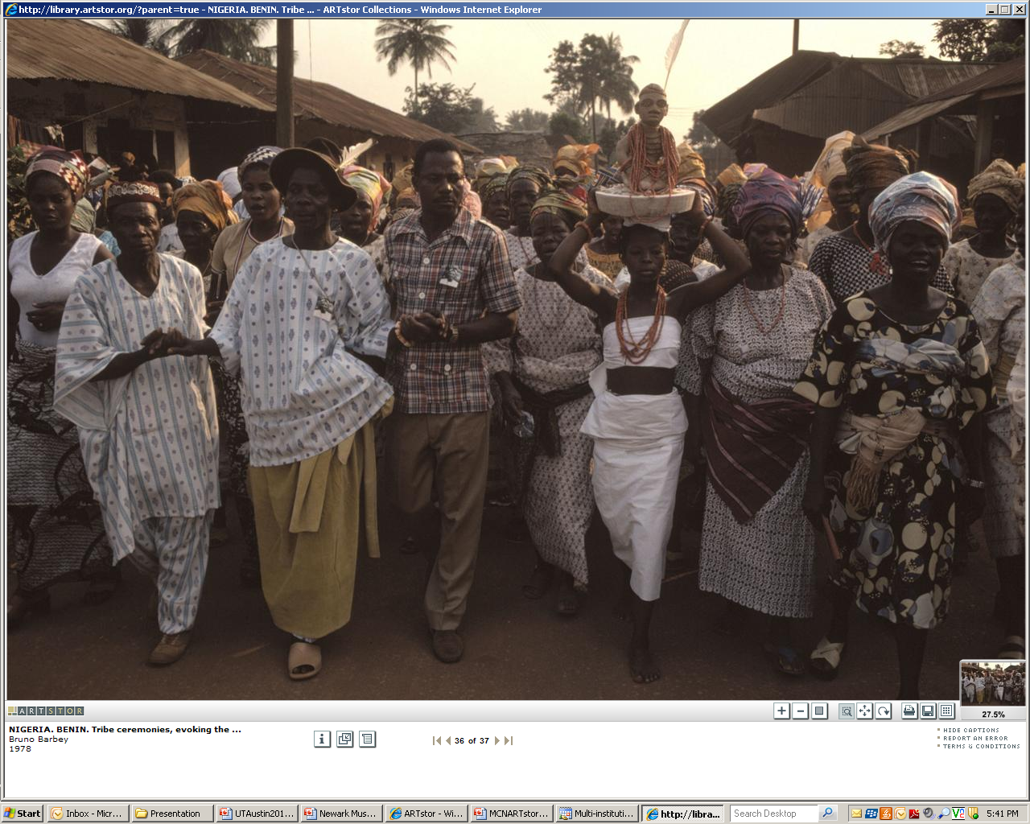
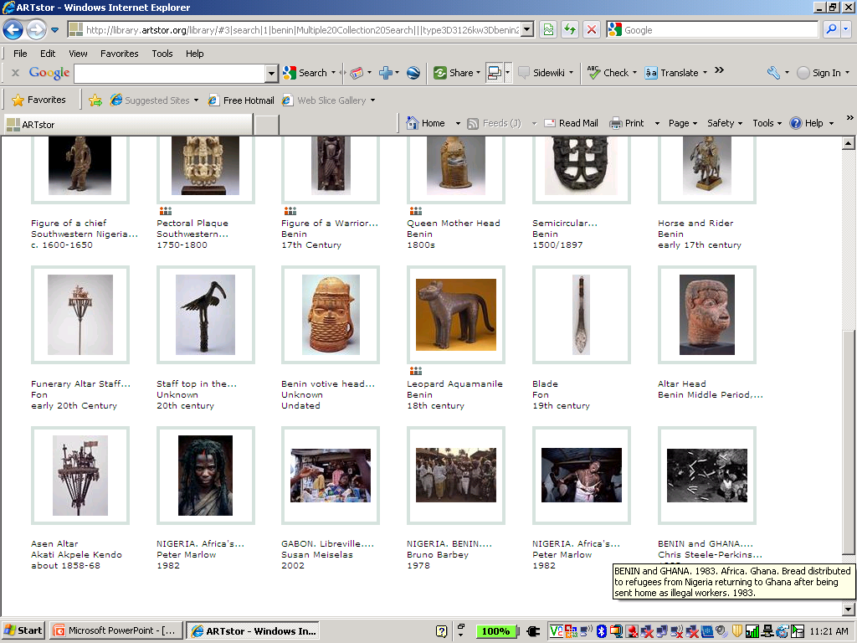
Discover related images

Slide 20
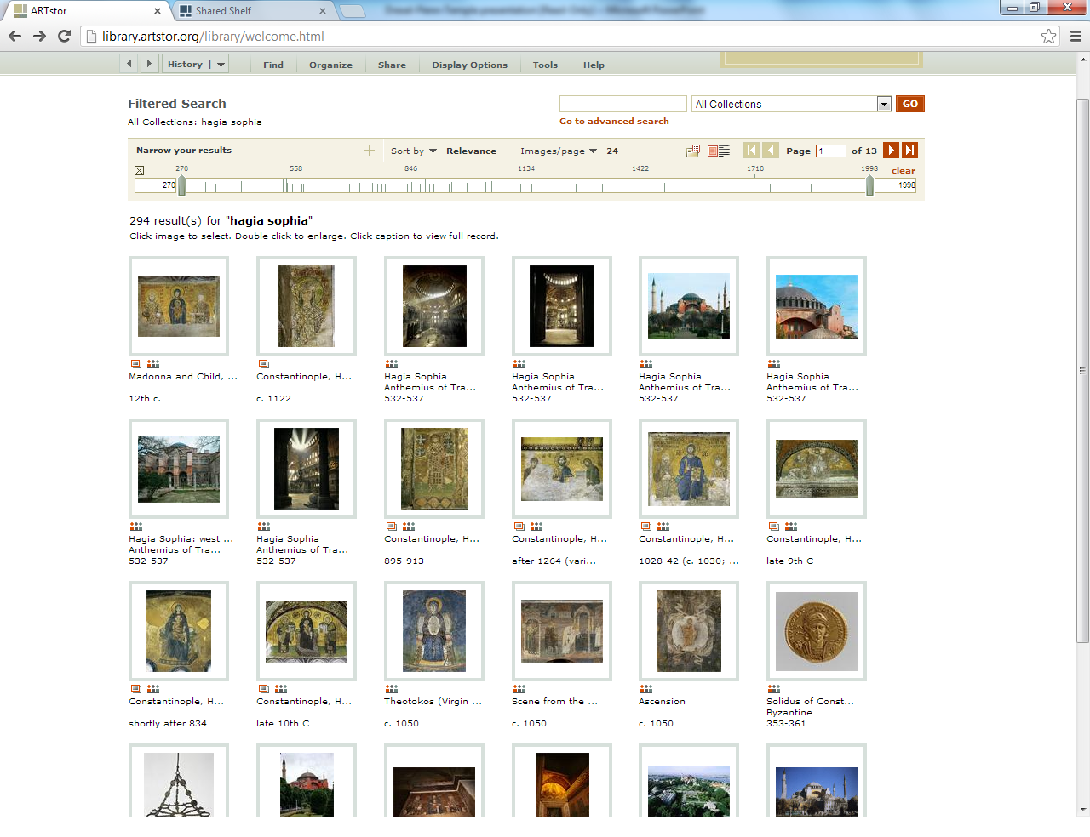
Hagia Sophia screen shot

Slide 21
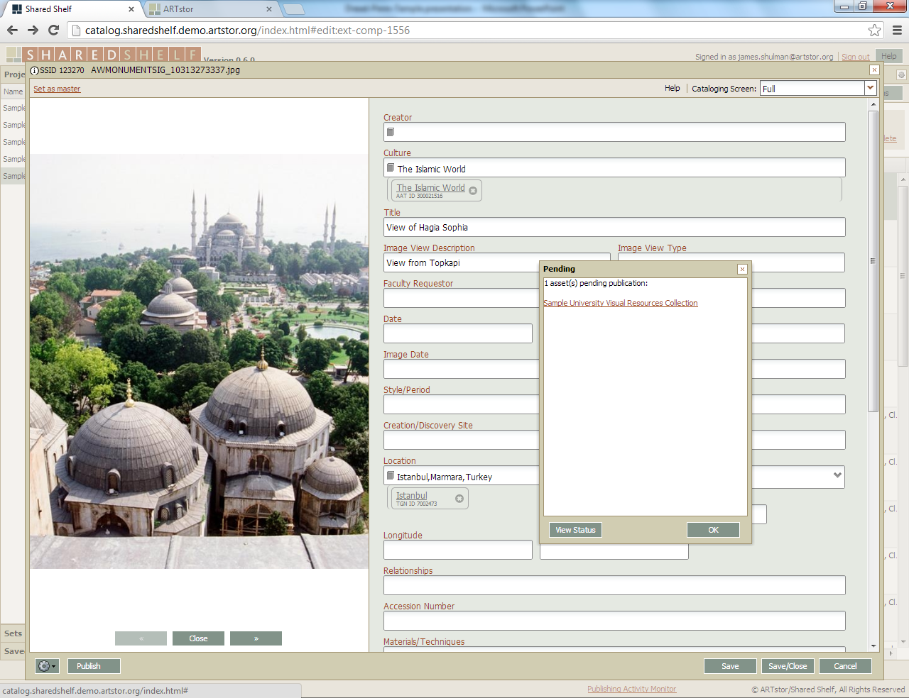

Slide 22
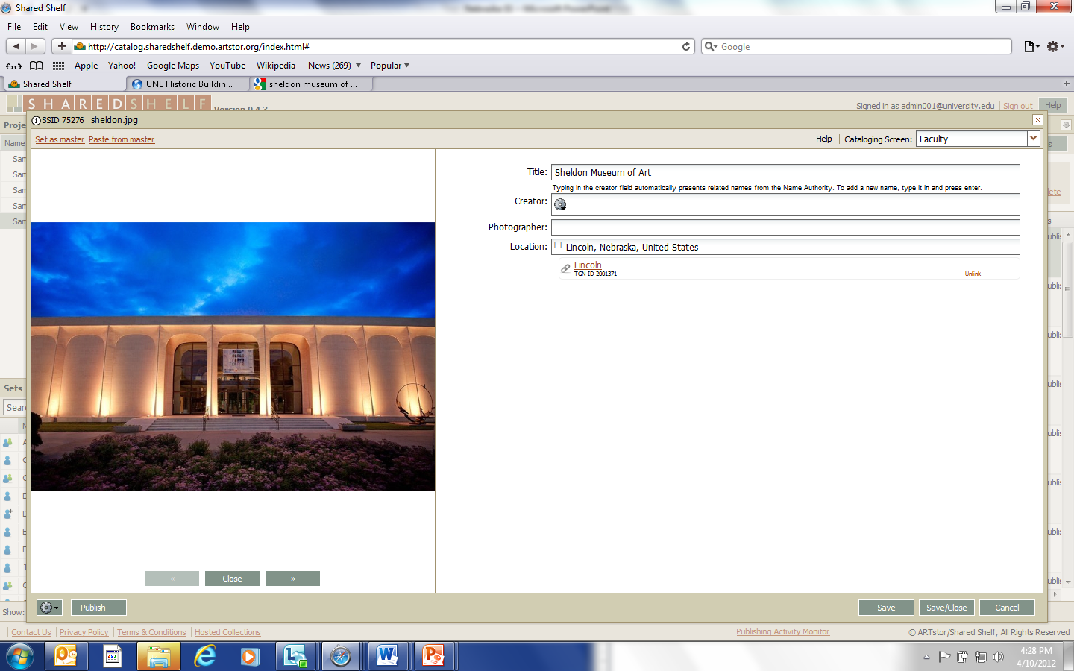
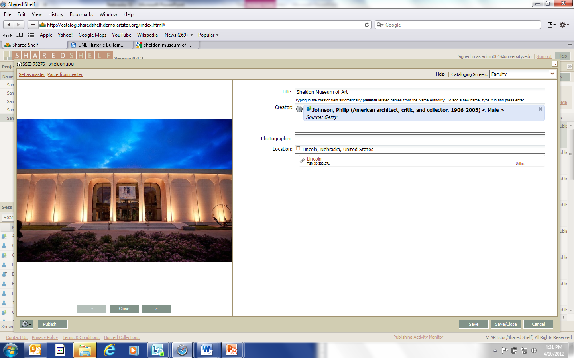
Simple Cataloging Screens
Featuring the Getty’s ULAN & TGN vocabularies
Notes:
Metadata schemas and cataloging screens are completely customizable. Full size, zoomable images available during cataloging. Draw upon integrated Getty vocabularies or add your own vocabulary values and share with the community. Download the full size source image at any time.

Slide 23
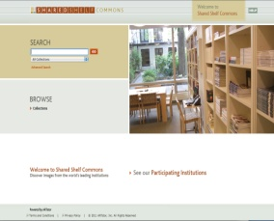
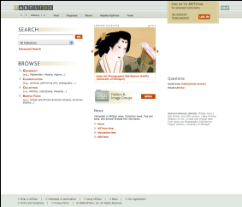
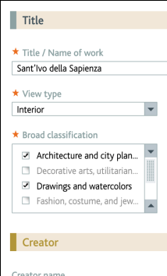
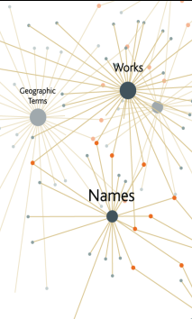
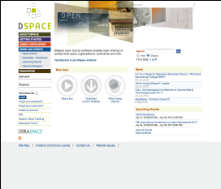
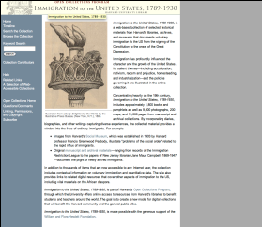

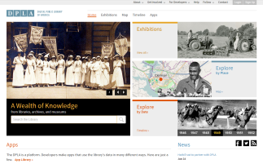
Local Content and Shared Shelf Infrastructure
Shared Shelf Commons
Mixing local & ARTstor content
Cataloging
environment
Shared vocabularies
Cloud
Computing
Institutional
repository (API)
Asset
management
API
Web exhibitions (future)
DPLA
Notes:
Harnessing the power of cloud computing
-Content going into cloud (remotely stored), can get content out of cloud
-Components don’t live locally, can be released directly from the cloud to end users using standard web browsers
-You don’t have to worry about supporting infrastructure, servers. Everything is handled remotely.

Slide 24





Content
AVIADOR
Videodisc Index

Slide 25
BWR ‘seed’ content
Goal: registry of ~100,000 unique identified built works
Identify, extract, & verify data from five sources:
    Harvard’s Olivia 2.5M > 392,917 > 55,621
    Cornell’s Pictor 24K > 13,847 > 1,611
    Avery’s AVIADOR 40K > 4,878
    Avery Index 650K records = subject term strings ~433,131
    ARTstor 1.4M records = built work image records ~70,000

Slide 26
Content development
Aggregate
Disambiguate
Normalize
Enhance
  CONA merge tools: Loader & Processor
  ARTstor parsing tools
  Google Refine

Slide 27
Field Name | AVIADOR | Harvard | Cornell | Avery | ARTstor
Title/Name of Building | Fallingwater, Kaufmann House | Fallingwater, Edgar J. Kaufmann House, Kaufmann House | Falling Water, Edgar J. Kaufmann Residence | Fallingwater (Kaufmann house). | Fallingwater, Edgar J. Kaufmann House, Kaufmann House
Location | Bear Run, (Pa.) | Bear Run, Pennsylvania, United States | Bear Run, PA, United States, North and Central America | Bear Run (Pennsylvania), United States | Mill Run, Pennsylvania, United States
Creator | Wright, Frank Lloyd One record with Ferriss, Hugh | Wright, Frank Lloyd | Wright, Frank Lloyd | Wright, Frank Lloyd | Wright, Frank Lloyd
Date |  | 1935-1939 | 1934-1938 |  | 1935-1936
Work Type | Vacation houses, Houses, Country Houses | houses | House |  | House
Style/Period |  |  | Modern |  | Modernist
Subject |  | Summer houses; vacation houses; terrace houses; hillside architecture | Houses |  | Dwellings, Houses, Cantilevers, Waterfalls, Architecture—United States, National Historic Landmarks Program (U.S.), Architecture, Modern—20th century, Kaufmann, Edgar J., 1885-1955
Culture |  | American | American
Description |  |  | Modern Architecture
Other names |  | Kaufmann, Edgar J. (patron)

Slide 28
Disambiguate criteria
We all know that if two records both have “Notre Dame” and “France” is not sufficient to de-duplicate these two records.
Is “Notre Dame” and “Paris, France” sufficient?
The question is how “granular” do we need to go to gain confidence in “automatic” de-duplication.
We hope to report on our results in the next CNI meeting.

Slide 29
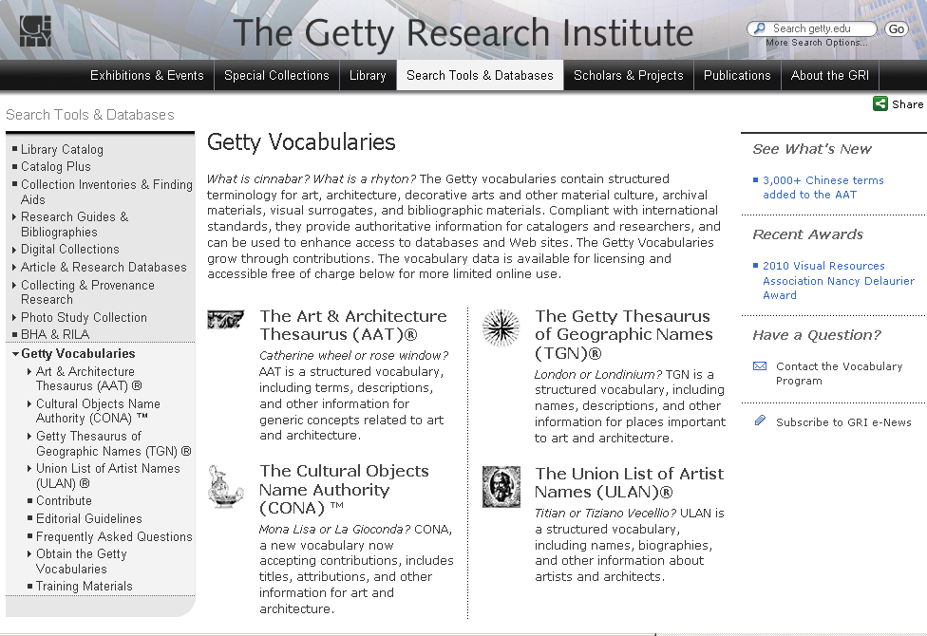
Authority

Slide 30
How will BWR gain scale?
Institutional contributory model
  Governed by policy framework
  Accessed through shared technical infrastructure
    Web-based data entry environment
    Ubiquitous network (Cloud)
  Shared via open APIs
Expert crowdsourcing experiment
  Community-driven approach to shared solutions
  Controlled by role-based access control system

Slide 31
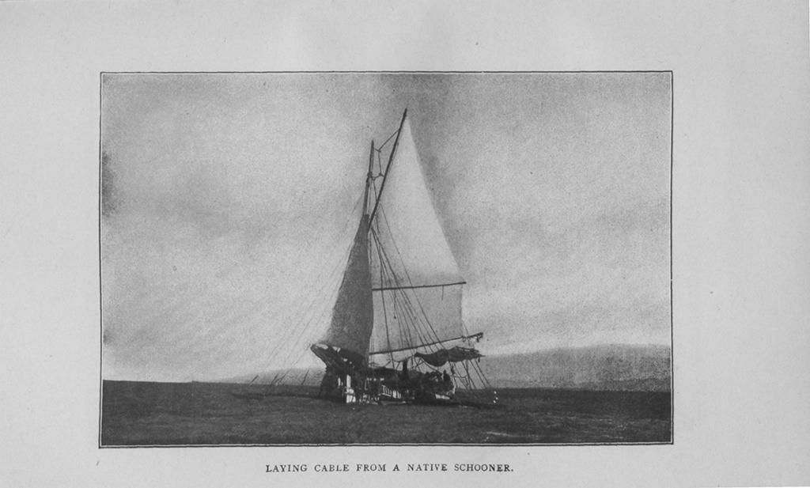
The Built Works Registry and the Infrastructure to Support it
James Shulman
From, Philippine life in town and country: 1905.

Slide 32
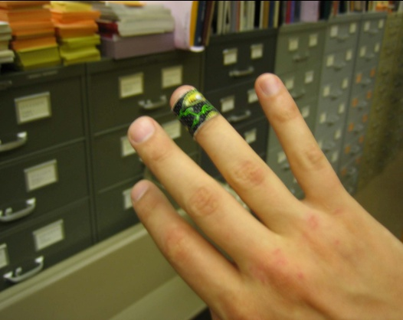
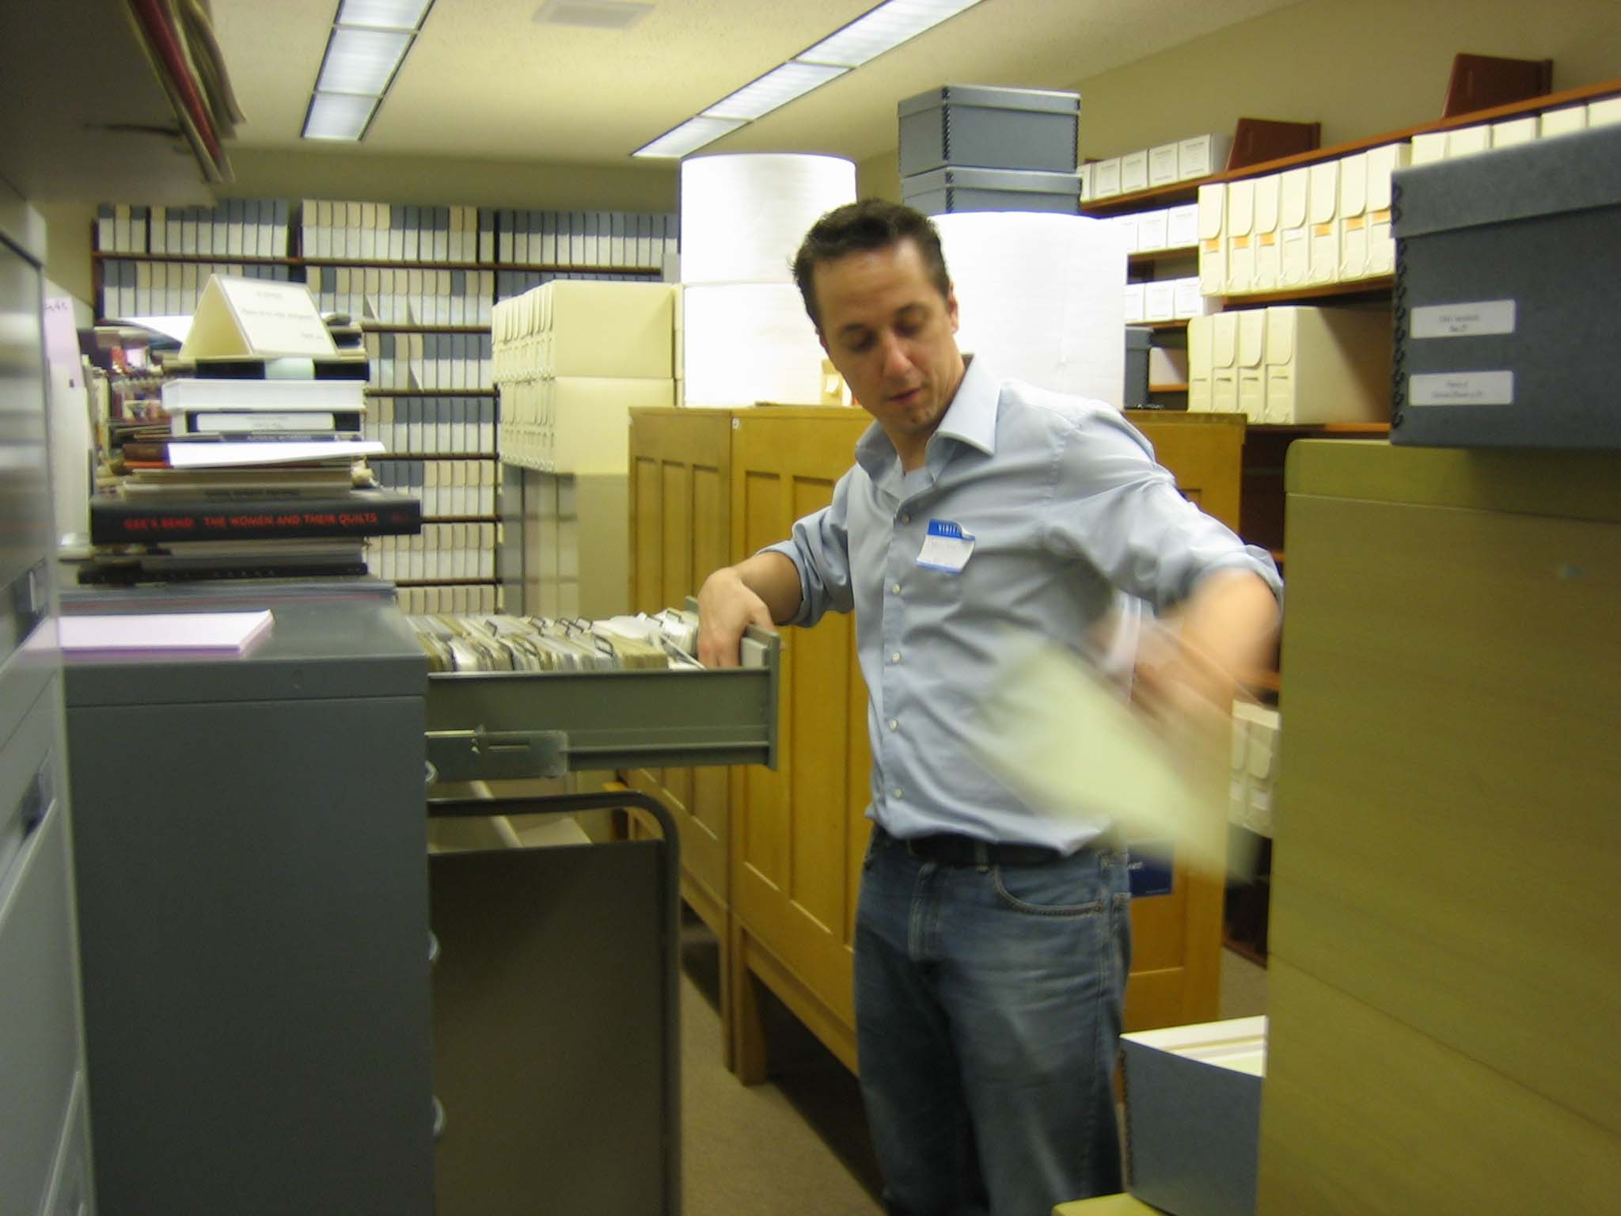
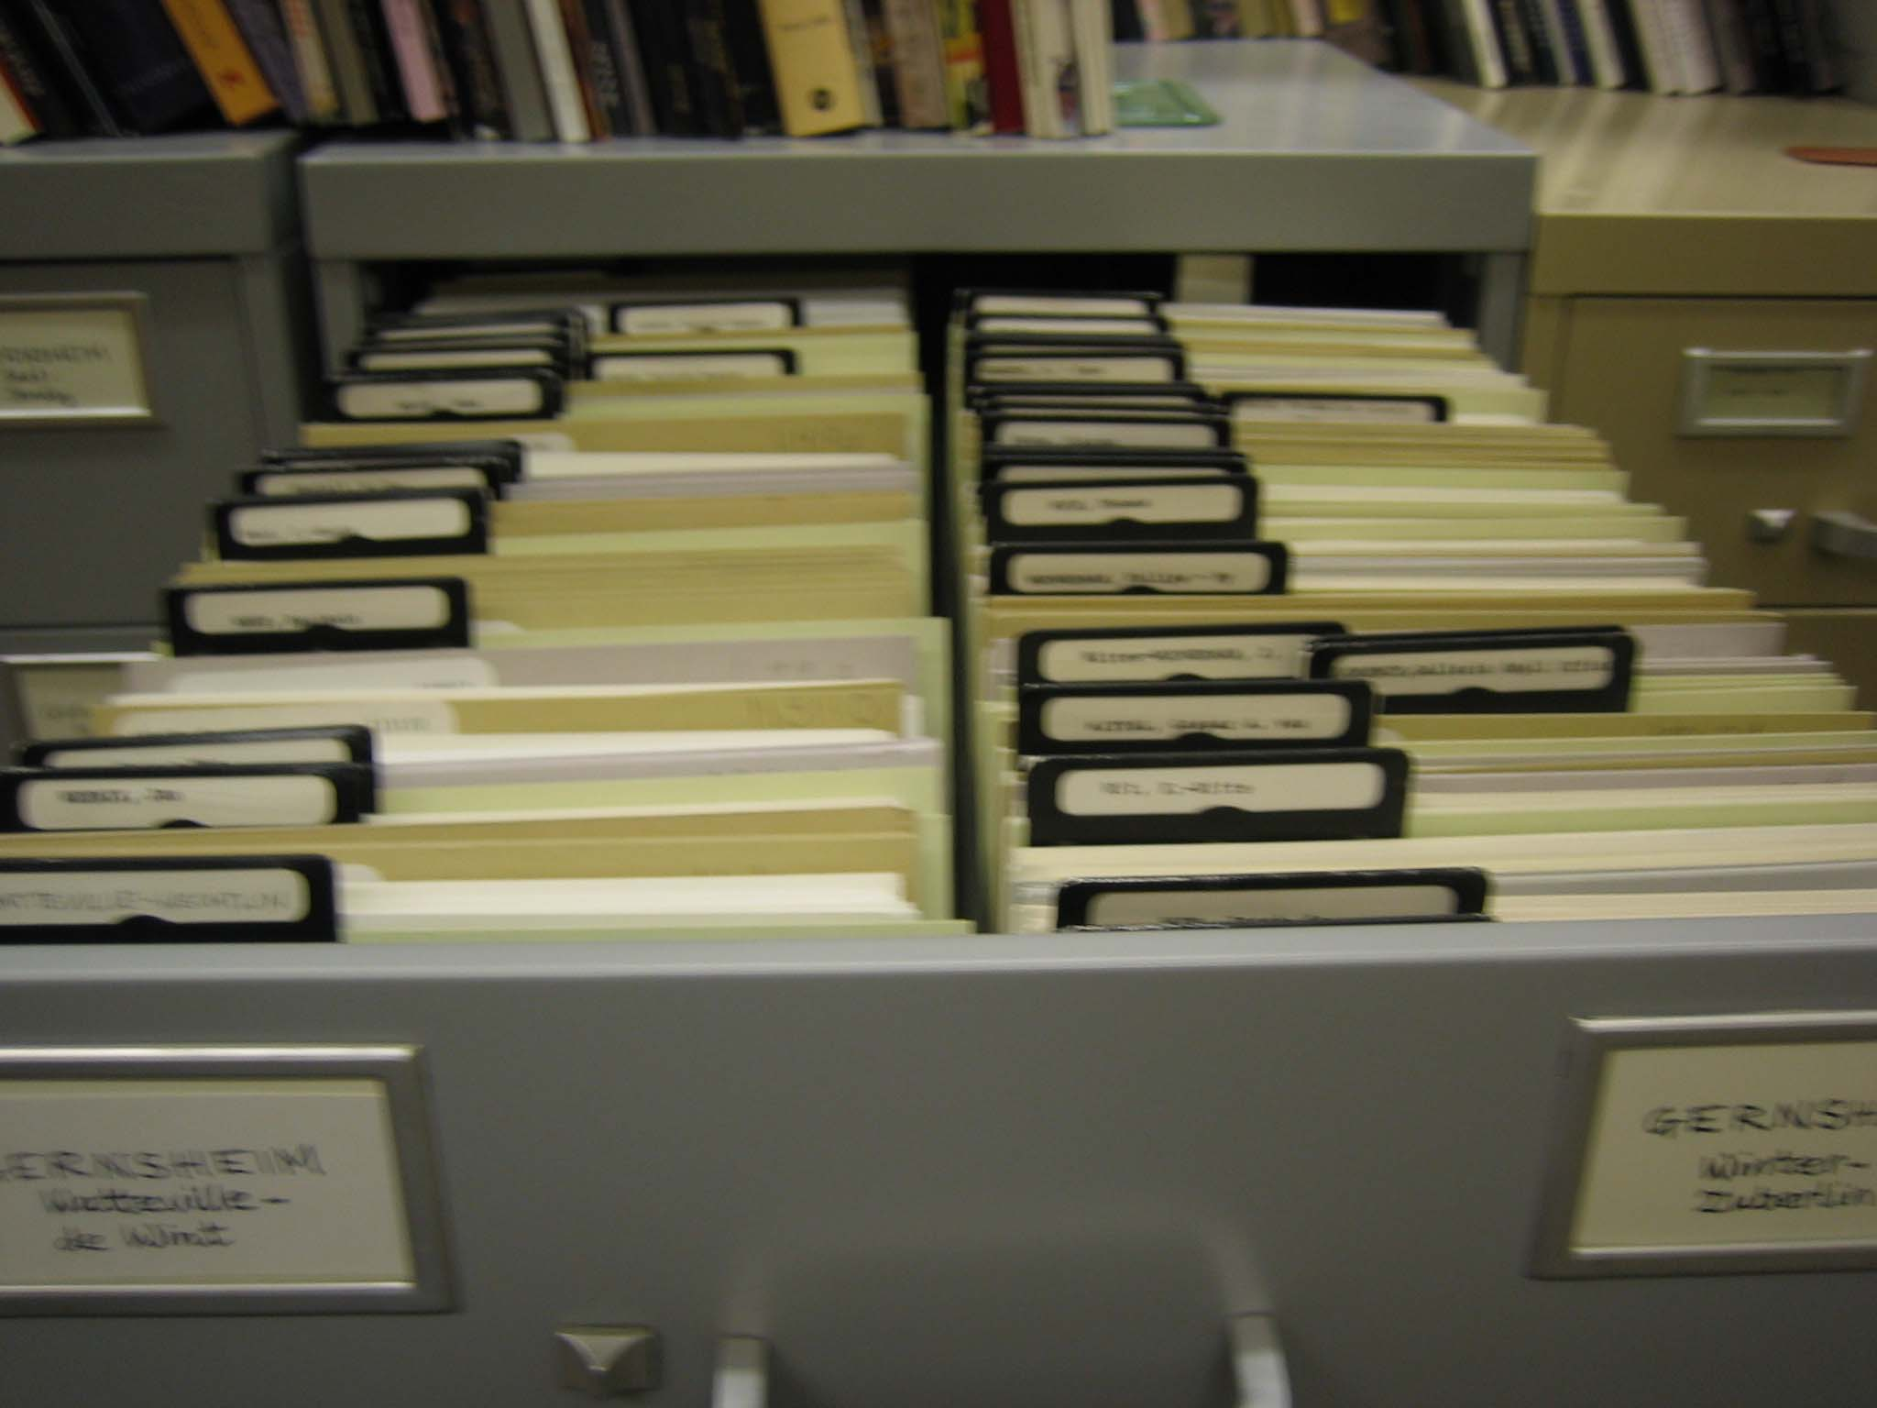
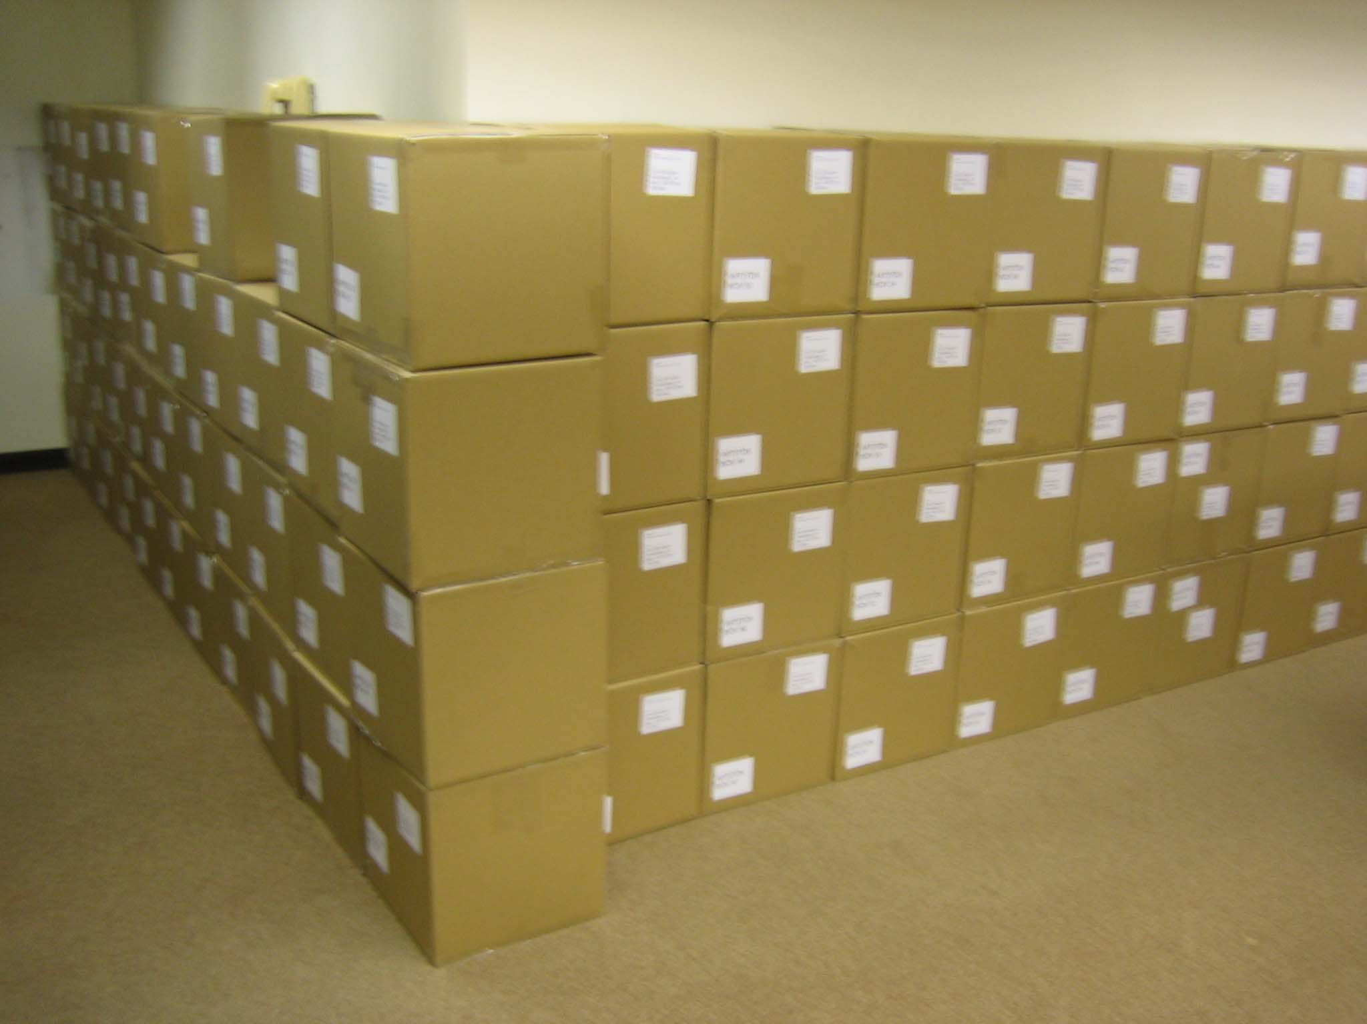
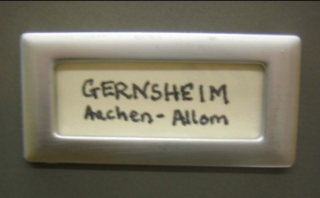
Gernsheim Photographic Corpus of Drawings
Page 32
Notes:
City, August 1, 2006 | Title | 32

Slide 33
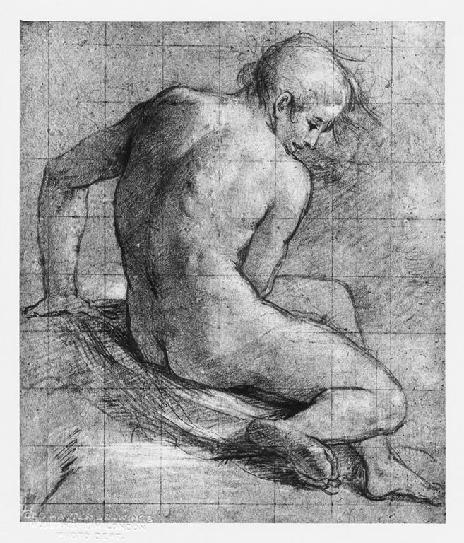
Notes:
Creator: Federico Barocci (1528-1612)
Title: Nude seated, seen from behind
Material: black chalk heightened with white on blue paper, squared
Measurements: 313:00;266 mm
Repository: British Museum. Dept. of Prints and Drawings
Repository: http://www.britishmuseum.org/
Collection: Gernsheim Photographic Corpus of Drawings
ID Number: 348
Source: Image and original data provided by the Gernsheim Photographic Corpus of Drawings established in 1937
Rights: Please note that if this image is under copyright, you may need to contact one or more copyright owners for any use that is not permitted under the ARTstor Terms and Conditions of Use or not otherwise permitted by law. While ARTstor tries to update contact information, it cannot guarantee that such information is always accurate. Determining whether those permissions are necessary, and obtaining such permissions, is your sole responsibility.

Slide 34
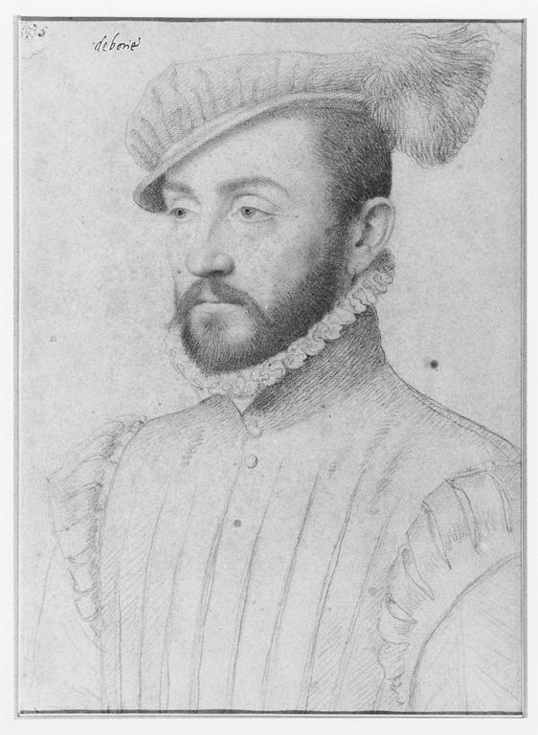
Notes:
Creator: François Clouet (ca. 1516-1572)
Title: Portrait 'De Boisy'
Material: black and colored chalks
Measurements: 310 x 218 mm
Repository: Fogg Art Museum; 1946.5
Repository: http://www.artmuseums.harvard.edu/fogg/
Collection: Gernsheim Photographic Corpus of Drawings
ID Number: 91590
Source: Image and original data provided by the Gernsheim Photographic Corpus of Drawings established in 1937
Rights: Please note that if this image is under copyright, you may need to contact one or more copyright owners for any use that is not permitted under the ARTstor Terms and Conditions of Use or not otherwise permitted by law. While ARTstor tries to update contact information, it cannot guarantee that such information is always accurate. Determining whether those permissions are necessary, and obtaining such permissions, is your sole responsibility.

Slide 35
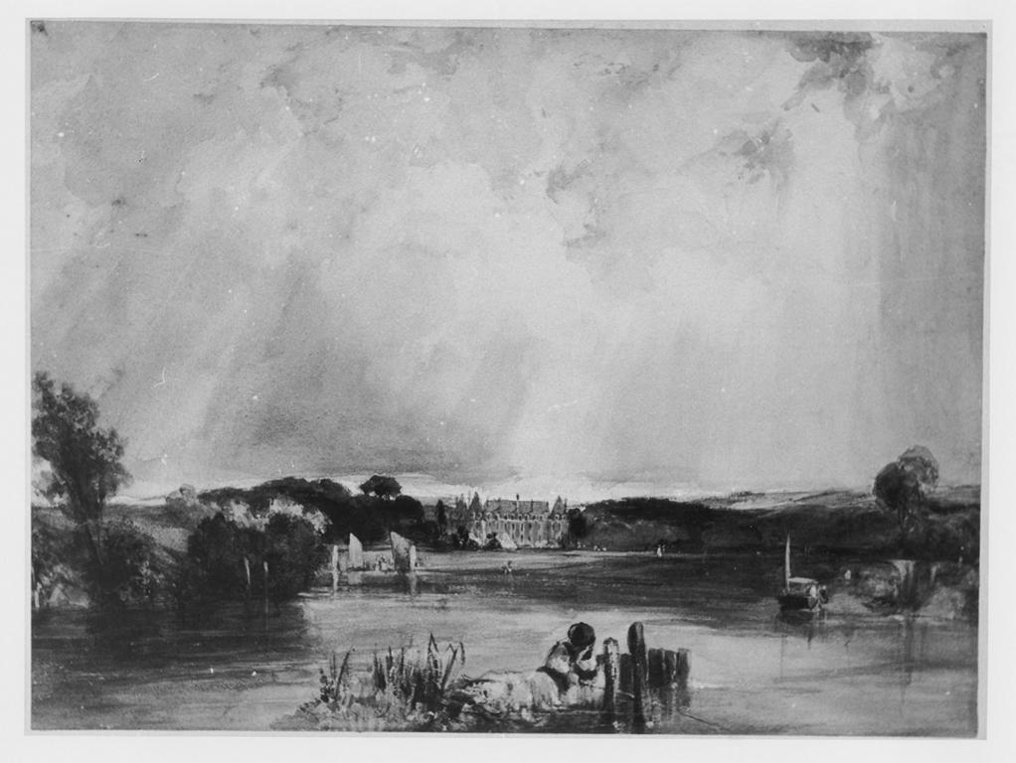
Notes:
Creator: Richard Parkes Bonington (1802-1828)
Title: River scene - the Château of the Duchesse de Berry at Rosny
Date: 1825
Material: watercolour and bodycolour
Measurements: 203 x 272 mm
Description: See "London - World City 1800-1840" catalogue of an exhibition in Essen, 1992, No 245.
Repository: British Museum Dept. of Prints and Drawings, 1910-2-12-223
Repository: http://www.britishmuseum.org/
Collection: Gernsheim Photographic Corpus of Drawings
ID Number: 13065
Source: Image and original data provided by the Gernsheim Photographic Corpus of Drawings established in 1937
Rights: Please note that if this image is under copyright, you may need to contact one or more copyright owners for any use that is not permitted under the ARTstor Terms and Conditions of Use or not otherwise permitted by law. While ARTstor tries to update contact information, it cannot guarantee that such information is always accurate. Determining whether those permissions are necessary, and obtaining such permissions, is your sole responsibility.

Slide 36
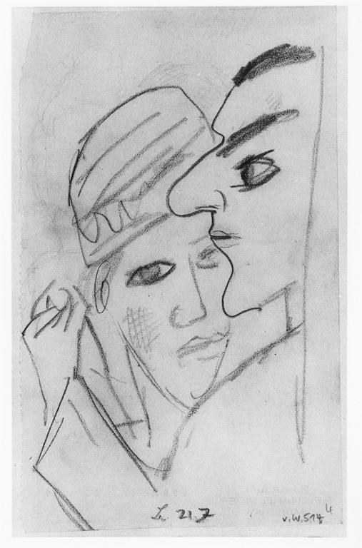
Notes:
Creator: Max Beckmann (1884-1950)
Title: Heads of a dancing couple
Date: 1922
Material: graphite
Measurements: 159 x 96 mm
Description: Signed with artist's monogram and dated "21.7" Bears collector mark of Reinhard Piper on verso ('Sammlung Reinhard Piper München'', undescribed in Lugt).
Repository: British Museum. Dept. of Prints and Drawings, 1981-7-25-39
Repository: http://www.britishmuseum.org/
Collection: Gernsheim Photographic Corpus of Drawings
ID Number: 119876
Source: Image and original data provided by the Gernsheim Photographic Corpus of Drawings established in 1937
Rights: Please note that if this image is under copyright, you may need to contact one or more copyright owners for any use that is not permitted under the ARTstor Terms and Conditions of Use or not otherwise permitted by law. While ARTstor tries to update contact information, it cannot guarantee that such information is always accurate. Determining whether those permissions are necessary, and obtaining such permissions, is your sole responsibility.

Slide 37
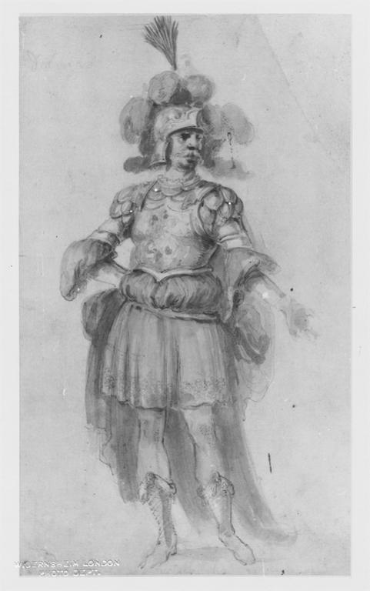
Notes:
Creator: Stefano della Bella (1610-1664)
Title: Costume study for Delmiro
Material: graphite, with watercolour and some pen and brown ink
Measurements: 302 x 180 mm
Description: Formerly in an album. The album once contained sixty-three drawings by Stefano della Bella, of costume designs, which are now mounted. On the front cover of the album are the arms of Cardinal Giovanni Carlo de' Medici and on the back those of the Accademia degli Immobili. The Academy was founded in 1649 by a group of Florentine noblemen who put on, and took part in, plays in their own theatre, the Teatro della Pergola (See P. Dearborn Massar, 'Costume Drawings by Stefano della Bella for the Florentine Theater', "Master Drawings", VIII, 3, 1970, pp.243-266).
Description: Inscribed: "delmiro"
Repository: British Museum. Dept. of Prints and Drawings, 1887-5-2-48
Repository: http://www.britishmuseum.org/
Collection: Gernsheim Photographic Corpus of Drawings
ID Number: 4783
Source: Image and original data provided by the Gernsheim Photographic Corpus of Drawings established in 1937
Rights: Please note that if this image is under copyright, you may need to contact one or more copyright owners for any use that is not permitted under the ARTstor Terms and Conditions of Use or not otherwise permitted by law. While ARTstor tries to update contact information, it cannot guarantee that such information is always accurate. Determining whether those permissions are necessary, and obtaining such permissions, is your sole responsibility.

Slide 38
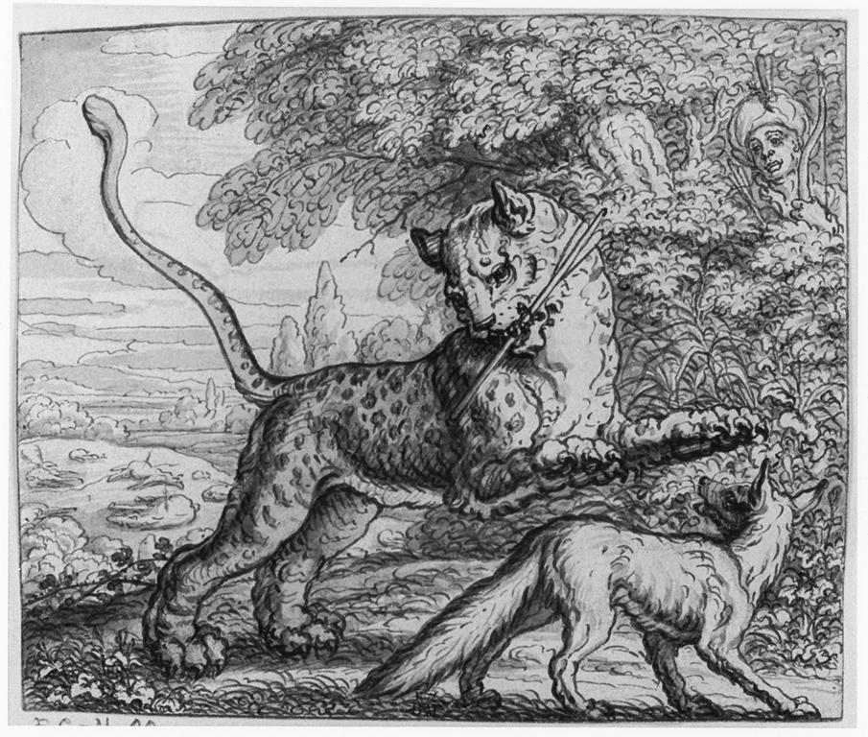
Notes:
Creator: Francis Barlow (ca. 1626-1704)
Title: Illustration to Aesop's Fables with his life; Fable XXXI, 'The tygre and fox'
Material: pen and brown ink, with grey wash
Measurements: 129 x 160 mm
Description: Drawing from an album bound in white vellum gilt (approx. 85 drawings in series). Etched by Barlow, in reverse (first published in Aesop's Fables, 1666 edition), with modifications. See LS & CW, No's 103-108 for further bibliographical references. Found with: 1858,0626.372-407; 1867,0413.320-395; 1855,0714.66. The drawing for Fable XXXII, 'The lioness and fox' is missing.
Repository: British Museum. Dept. of Prints and Drawings, 1867-4-13-364
Repository: http://www.britishmuseum.org/
Collection: Gernsheim Photographic Corpus of Drawings
ID Number: 129744
Source: Image and original data provided by the Gernsheim Photographic Corpus of Drawings established in 1937
Rights: Please note that if this image is under copyright, you may need to contact one or more copyright owners for any use that is not permitted under the ARTstor Terms and Conditions of Use or not otherwise permitted by law. While ARTstor tries to update contact information, it cannot guarantee that such information is always accurate. Determining whether those permissions are necessary, and obtaining such permissions, is your sole responsibility.

Slide 39
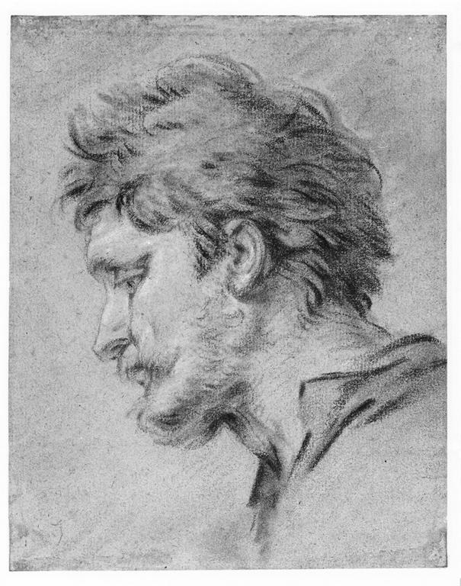
Notes:
Creator: François Boucher (1703-1770)
Title: Head of a shepherd; study for an altarpiece
Material: red, black and blue chalk, heightened with white; on brown paper
Measurements: 186 x 145 mm
Description: Study for the altarpiece, The Nativity, at the Oratory of Mme de Pompadour, Chateau de Bellevue.
Repository: British Museum Dept. of Prints and Drawings, 1963-12-14-4; British Museum Dept. of Prints and Drawings, 1946-7-13-279; British Museum Dept. of Prints and Drawings, 1853-8-13-25; British Museum Dept. of Prints and Drawings, 1946-7-13-279
Repository: http://www.britishmuseum.org/
Collection: Gernsheim Photographic Corpus of Drawings
ID Number: 109989
Source: Image and original data provided by the Gernsheim Photographic Corpus of Drawings established in 1937
Rights: Please note that if this image is under copyright, you may need to contact one or more copyright owners for any use that is not permitted under the ARTstor Terms and Conditions of Use or not otherwise permitted by law. While ARTstor tries to update contact information, it cannot guarantee that such information is always accurate. Determining whether those permissions are necessary, and obtaining such permissions, is your sole responsibility.

Slide 40
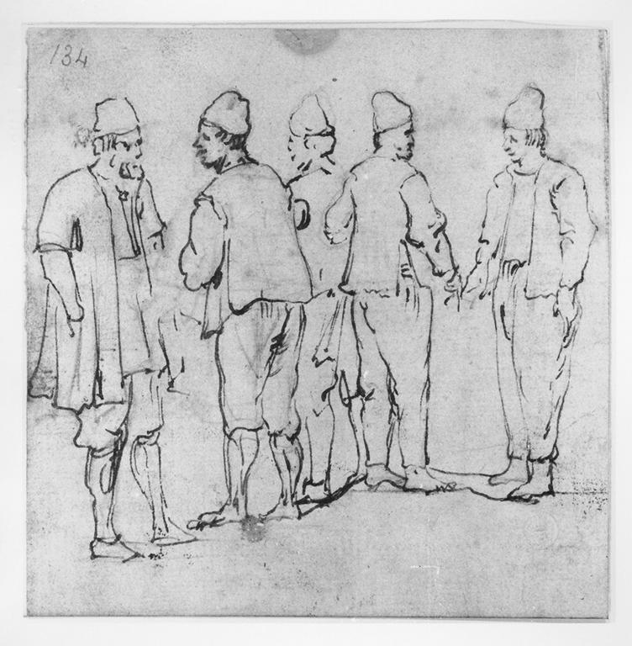
Notes:
Creator: Luca Carlevariis (1663-1729)
Title: Group of male figures
Material: pen over black chalk
Measurements: 125 x 123 mm
Repository: Victoria and Albert Museum. Dept. of Prints and Drawings; D. 1089-1900
Repository: http://www.vam.ac.uk/
Collection: Gernsheim Photographic Corpus of Drawings
ID Number: 54501
Source: Image and original data provided by the Gernsheim Photographic Corpus of Drawings established in 1937
Rights: Please note that if this image is under copyright, you may need to contact one or more copyright owners for any use that is not permitted under the ARTstor Terms and Conditions of Use or not otherwise permitted by law. While ARTstor tries to update contact information, it cannot guarantee that such information is always accurate. Determining whether those permissions are necessary, and obtaining such permissions, is your sole responsibility.

Slide 41
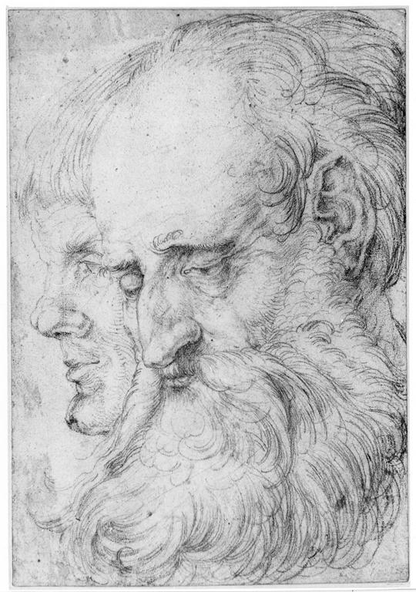
Notes:
Creator: Hans Baldung (1484/1485-1545); Hans Schäufelein the elder (ca. 1482-1539/1540)
Title: Study of the heads of two men
Date: 1512-1516
Material: red chalk, over black chalk
Measurements: 288 x 201 mm
Description: Lit: Michael Roth, 'Dürer's Mutter: Schönheit, Alter und Tod im Bild der Renaissance', exh.cat. Berlin, Kupferstichkabinett, 2006, no. 61
Repository: British Museum. Dept. of Prints and Drawings, 1949-4-11-106
Repository: http://www.britishmuseum.org/
Collection: Gernsheim Photographic Corpus of Drawings
ID Number: 28755
Source: Image and original data provided by the Gernsheim Photographic Corpus of Drawings established in 1937
Rights: Please note that if this image is under copyright, you may need to contact one or more copyright owners for any use that is not permitted under the ARTstor Terms and Conditions of Use or not otherwise permitted by law. While ARTstor tries to update contact information, it cannot guarantee that such information is always accurate. Determining whether those permissions are necessary, and obtaining such permissions, is your sole responsibility.

Slide 42
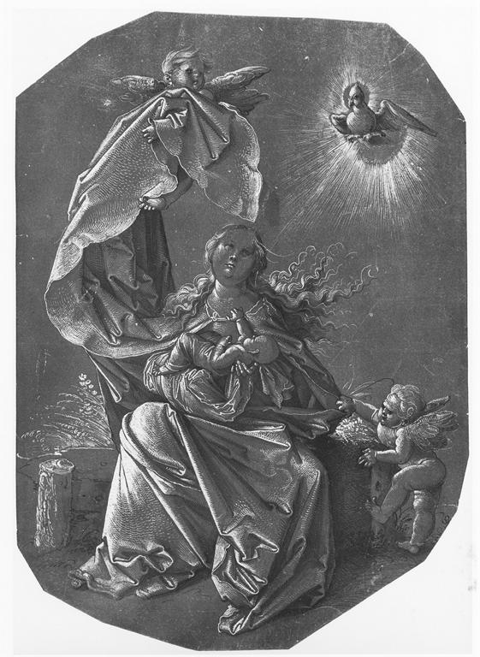
Notes:
Creator: Hans Baldung (1484/1485-1545)
Title: The Virgin and Child seated on a bank, with two attendant angels
Date: 1515-1520
Material: pen and black ink, heightened with white; on dark brown prepared paper
Measurements: 279 x 195 mm
Description: Inscribed by an early hand with Dürer's monogram and the date: "1518"
Repository: British Museum. Dept. of Prints and Drawings, SL-5218-179
Repository: http://www.britishmuseum.org/
Collection: Gernsheim Photographic Corpus of Drawings
ID Number: 28732
Source: Image and original data provided by the Gernsheim Photographic Corpus of Drawings established in 1937
Rights: Please note that if this image is under copyright, you may need to contact one or more copyright owners for any use that is not permitted under the ARTstor Terms and Conditions of Use or not otherwise permitted by law. While ARTstor tries to update contact information, it cannot guarantee that such information is always accurate. Determining whether those permissions are necessary, and obtaining such permissions, is your sole responsibility.

Slide 43
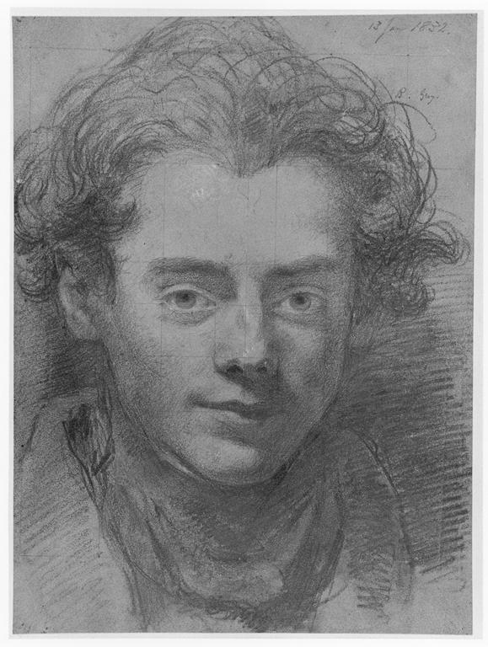
Notes:
Creator: William Bradley (1801-1857)
Title: Portrait of Henry Liverseege
Date: 1832
Material: graphite, heightened with white, touched with red and blue chalk, on grey-green pape
Measurements: 338 x 248 mm
Description: Dated: "13 Jan 1832" and inscribed: "R. Grey."
Repository: British Museum Dept. of Prints and Drawings, 1908-6-6-1; British Museum Dept. of Prints and Drawings, 1946-7-13-279; British Museum Dept. of Prints and Drawings, 1853-8-13-25; British Museum Dept. of Prints and Drawings, 1946-7-13-279
Repository: http://www.britishmuseum.org/
Collection: Gernsheim Photographic Corpus of Drawings
ID Number: 121909
Source: Image and original data provided by the Gernsheim Photographic Corpus of Drawings established in 1937
Rights: Please note that if this image is under copyright, you may need to contact one or more copyright owners for any use that is not permitted under the ARTstor Terms and Conditions of Use or not otherwise permitted by law. While ARTstor tries to update contact information, it cannot guarantee that such information is always accurate. Determining whether those permissions are necessary, and obtaining such permissions, is your sole responsibility.

Slide 44
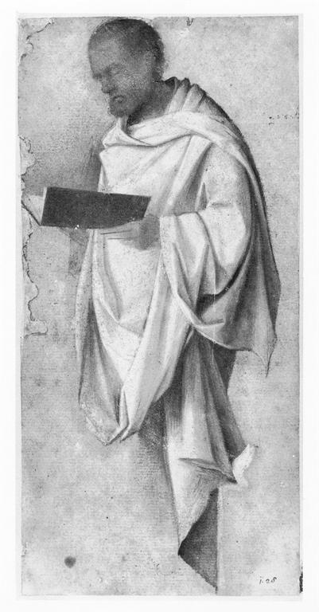
Notes:
Creator: Giovanni Bellini (1431-1436, died 1516)
Title: Drapery study for a male saint
Material: oil
Measurements: 224 x 106 mm
Description: Corresponds in reverse with the figure of St. Peter in the engraving by Mocetto 'Virgin enthroned with St. John the Baptist, St. Peter and three female saints' (Pass, V, p.136, 10) that must be related to a lost altarpiece by Giovanni Bellini. Lit: A.E. Popham and P. Pouncey, 'Italian drawings in the BM, the fourteenth and fifteenth centuries', London, 1950, I, no. 19, II, pl. XVII (with previous literature).
Repository: British Museum. Dept. of Prints and Drawings, 1902-8-22-4
Repository: http://www.britishmuseum.org/
Collection: Gernsheim Photographic Corpus of Drawings
ID Number: 37300
Source: Image and original data provided by the Gernsheim Photographic Corpus of Drawings established in 1937
Rights: Please note that if this image is under copyright, you may need to contact one or more copyright owners for any use that is not permitted under the ARTstor Terms and Conditions of Use or not otherwise permitted by law. While ARTstor tries to update contact information, it cannot guarantee that such information is always accurate. Determining whether those permissions are necessary, and obtaining such permissions, is your sole responsibility.

Slide 45
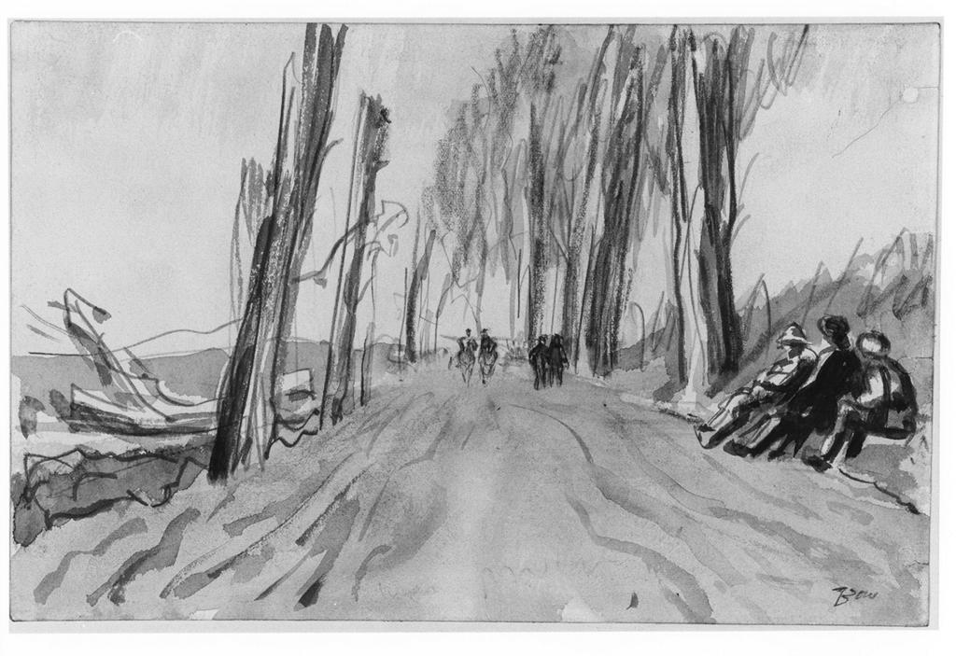
Notes:
Creator: Muirhead Bone (1876-1953)
Title: The road to Maricourt
Date: 1914-1918
Material: graphite and grey wash
Measurements: 155 x 237 mm
Description: Inscribed: "Bone"
Repository: British Museum Dept. of Prints and Drawings, 1919-2-8-12
Repository: http://www.britishmuseum.org/
Collection: Gernsheim Photographic Corpus of Drawings
ID Number: 145402
Source: Image and original data provided by the Gernsheim Photographic Corpus of Drawings established in 1937
Rights: Please note that if this image is under copyright, you may need to contact one or more copyright owners for any use that is not permitted under the ARTstor Terms and Conditions of Use or not otherwise permitted by law. While ARTstor tries to update contact information, it cannot guarantee that such information is always accurate. Determining whether those permissions are necessary, and obtaining such permissions, is your sole responsibility.

Slide 46
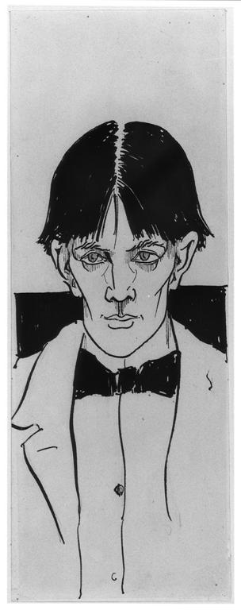
Notes:
Creator: Aubrey Vincent Beardsley (1872-1898)
Title: Self-portrait
Date: 1892
Material: pen and black ink, with black wash
Measurements: 252 x 95 mm
Description: This early self-portrait was not made for a particular publication, and was first reproduced after Beardsley's death in 'A Second Book of Drawings', London (Leonard Smithers) 1899, p.13. The donor, Robert Ross, was grandson of the first prime minister of Upper Canada, and a close friend of Beardsley whom he first met on 14 February 1892 (see 'Aubrey Beardsley', exhibition catalogue, Victoria & Albert Museum 1966, no.140). The drawing was probably made for him shortly afterwards. Ross published a famous biography of Beardsley in 1909 (where this drawing is no. 39 in the checklist), and was literary executor for Oscar Wilde.
Repository: British Museum. Dept. of Prints and Drawings, 1906-4-23-1
Repository: http://www.britishmuseum.org/
Collection: Gernsheim Photographic Corpus of Drawings
ID Number: 145394
Source: Image and original data provided by the Gernsheim Photographic Corpus of Drawings established in 1937
Rights: Please note that if this image is under copyright, you may need to contact one or more copyright owners for any use that is not permitted under the ARTstor Terms and Conditions of Use or not otherwise permitted by law. While ARTstor tries to update contact information, it cannot guarantee that such information is always accurate. Determining whether those permissions are necessary, and obtaining such permissions, is your sole responsibility.

Slide 47
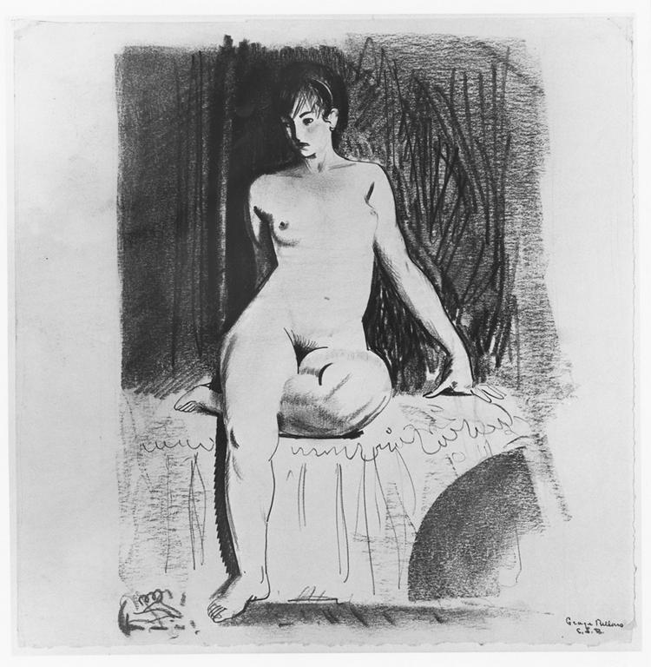
Notes:
Creator: George Wesley Bellows (1882-1925)
Title: Nude girl seated on bed
Material: black pen and chalk
Measurements: 252 x 245 mm
Repository: Cleveland Museum of Art; 1950.453
Repository: http://www.clemusart.com/
Collection: Gernsheim Photographic Corpus of Drawings
ID Number: 98247
Source: Image and original data provided by the Gernsheim Photographic Corpus of Drawings established in 1937
Rights: Please note that if this image is under copyright, you may need to contact one or more copyright owners for any use that is not permitted under the ARTstor Terms and Conditions of Use or not otherwise permitted by law. While ARTstor tries to update contact information, it cannot guarantee that such information is always accurate. Determining whether those permissions are necessary, and obtaining such permissions, is your sole responsibility.

Slide 48

Notes:
Creator: Alonso Berruguete (ca. 1480 - 1561)
Title: Assumption of the Virgin
Material: brush drawing in brown ink, with pen and brown ink and brown wash, heightened with white (oxidised)
Measurements: 313 x 193 mm
Repository: British Museum. Dept. of Prints and Drawings, 1895-9-15-866
Repository: http://www.britishmuseum.org/
Collection: Gernsheim Photographic Corpus of Drawings
ID Number: 5222
Source: Image and original data provided by the Gernsheim Photographic Corpus of Drawings established in 1937
Rights: Please note that if this image is under copyright, you may need to contact one or more copyright owners for any use that is not permitted under the ARTstor Terms and Conditions of Use or not otherwise permitted by law. While ARTstor tries to update contact information, it cannot guarantee that such information is always accurate. Determining whether those permissions are necessary, and obtaining such permissions, is your sole responsibility.

Slide 49

Notes:
Creator: Giacomo Cavedone (1577-1660)
Title: Saint Ambrose
Material: oily chalk heightened with white on brown paper
Measurements: 284 x 390 mm
Repository: Fogg Art Museum; 1957.134 (verso)
Repository: http://www.artmuseums.harvard.edu/fogg/
Collection: Gernsheim Photographic Corpus of Drawings
ID Number: 92625
Source: Image and original data provided by the Gernsheim Photographic Corpus of Drawings established in 1937
Rights: Please note that if this image is under copyright, you may need to contact one or more copyright owners for any use that is not permitted under the ARTstor Terms and Conditions of Use or not otherwise permitted by law. While ARTstor tries to update contact information, it cannot guarantee that such information is always accurate. Determining whether those permissions are necessary, and obtaining such permissions, is your sole responsibility.

Slide 50

Notes:
Creator: Charles Hamilton Aïdé (1826-1906)
Title: The Propylaea from the Parthenon, Athens
Date: 1899
Material: watercolour
Measurements: 348 x 529
Repository: British Museum. Dept. of Prints and Drawings, 1905-7-5-1
Repository: http://www.britishmuseum.org/
Collection: Gernsheim Photographic Corpus of Drawings
ID Number: 143330
Source: Image and original data provided by the Gernsheim Photographic Corpus of Drawings established in 1937
Rights: Please note that if this image is under copyright, you may need to contact one or more copyright owners for any use that is not permitted under the ARTstor Terms and Conditions of Use or not otherwise permitted by law. While ARTstor tries to update contact information, it cannot guarantee that such information is always accurate. Determining whether those permissions are necessary, and obtaining such permissions, is your sole responsibility.

Slide 51

Notes:
Creator: Luca Carlevariis (1663-1729)
Title: Venetian figure
Material: oil on canvas
Measurements: 185 x 112 mm
Repository: Victoria and Albert Museum. Dept. of Prints and Drawings; P 46-1938
Repository: http://www.vam.ac.uk/
Collection: Gernsheim Photographic Corpus of Drawings
ID Number: 100307
Source: Image and original data provided by the Gernsheim Photographic Corpus of Drawings established in 1937
Rights: Please note that if this image is under copyright, you may need to contact one or more copyright owners for any use that is not permitted under the ARTstor Terms and Conditions of Use or not otherwise permitted by law. While ARTstor tries to update contact information, it cannot guarantee that such information is always accurate. Determining whether those permissions are necessary, and obtaining such permissions, is your sole responsibility.

Slide 52

Notes:
Creator: Domenico Beccafumi (1486-1551)
Title: Rivergods
Material: black chalk heightened with white
Measurements: 232 x 411 mm
Repository: Cleveland Museum of Art; 1958.313
Repository: http://www.clemusart.com/
Collection: Gernsheim Photographic Corpus of Drawings
ID Number: 90012
Source: Image and original data provided by the Gernsheim Photographic Corpus of Drawings established in 1937
Rights: Please note that if this image is under copyright, you may need to contact one or more copyright owners for any use that is not permitted under the ARTstor Terms and Conditions of Use or not otherwise permitted by law. While ARTstor tries to update contact information, it cannot guarantee that such information is always accurate. Determining whether those permissions are necessary, and obtaining such permissions, is your sole responsibility.

Slide 53

Notes:
Creator: Edward Burne-Jones (1833-1898)
Title: Sketch-book, folio 8 (verso), folio 9
Material: pencil and leadpoint
Measurements: each, 253 x 139 mm
Repository: Victoria and Albert Museum. Dept. of Prints and Drawings; E. 1613-1926, fol.8 (verso), 9
Repository: http://www.vam.ac.uk/
Collection: Gernsheim Photographic Corpus of Drawings
ID Number: 62340
Source: Image and original data provided by the Gernsheim Photographic Corpus of Drawings established in 1937
Rights: Please note that if this image is under copyright, you may need to contact one or more copyright owners for any use that is not permitted under the ARTstor Terms and Conditions of Use or not otherwise permitted by law. While ARTstor tries to update contact information, it cannot guarantee that such information is always accurate. Determining whether those permissions are necessary, and obtaining such permissions, is your sole responsibility.

Slide 54

Notes:
Creator: David Young Cameron (1865-1945)
Title: Landscape with castle
Material: charcoal on light yellow paper
Measurements: 376 x 530 mm
Repository: Cleveland Museum of Art; 1940.728
Repository: http://www.clemusart.com/
Collection: Gernsheim Photographic Corpus of Drawings
ID Number: 87008
Source: Image and original data provided by the Gernsheim Photographic Corpus of Drawings established in 1937
Rights: Please note that if this image is under copyright, you may need to contact one or more copyright owners for any use that is not permitted under the ARTstor Terms and Conditions of Use or not otherwise permitted by law. While ARTstor tries to update contact information, it cannot guarantee that such information is always accurate. Determining whether those permissions are necessary, and obtaining such permissions, is your sole responsibility.

Slide 55

Notes:
Creator: David Young Cameron (1865-1945)
Title: Landscape with castle
Material: charcoal on light yellow paper
Measurements: 376 x 530 mm
Repository: Cleveland Museum of Art; 1940.728
Repository: http://www.clemusart.com/
Collection: Gernsheim Photographic Corpus of Drawings
ID Number: 87008
Source: Image and original data provided by the Gernsheim Photographic Corpus of Drawings established in 1937
Rights: Please note that if this image is under copyright, you may need to contact one or more copyright owners for any use that is not permitted under the ARTstor Terms and Conditions of Use or not otherwise permitted by law. While ARTstor tries to update contact information, it cannot guarantee that such information is always accurate. Determining whether those permissions are necessary, and obtaining such permissions, is your sole responsibility.

Slide 56


Notes:
Creator: David Young Cameron (1865-1945)
Title: Landscape with castle
Material: charcoal on light yellow paper
Measurements: 376 x 530 mm
Repository: Cleveland Museum of Art; 1940.728
Repository: http://www.clemusart.com/
Collection: Gernsheim Photographic Corpus of Drawings
ID Number: 87008
Source: Image and original data provided by the Gernsheim Photographic Corpus of Drawings established in 1937
Rights: Please note that if this image is under copyright, you may need to contact one or more copyright owners for any use that is not permitted under the ARTstor Terms and Conditions of Use or not otherwise permitted by law. While ARTstor tries to update contact information, it cannot guarantee that such information is always accurate. Determining whether those permissions are necessary, and obtaining such permissions, is your sole responsibility.

Slide 57


Notes:
Creator: David Young Cameron (1865-1945)
Title: Landscape with castle
Material: charcoal on light yellow paper
Measurements: 376 x 530 mm
Repository: Cleveland Museum of Art; 1940.728
Repository: http://www.clemusart.com/
Collection: Gernsheim Photographic Corpus of Drawings
ID Number: 87008
Source: Image and original data provided by the Gernsheim Photographic Corpus of Drawings established in 1937
Rights: Please note that if this image is under copyright, you may need to contact one or more copyright owners for any use that is not permitted under the ARTstor Terms and Conditions of Use or not otherwise permitted by law. While ARTstor tries to update contact information, it cannot guarantee that such information is always accurate. Determining whether those permissions are necessary, and obtaining such permissions, is your sole responsibility.

Slide 58


Notes:
Creator: David Young Cameron (1865-1945)
Title: Landscape with castle
Material: charcoal on light yellow paper
Measurements: 376 x 530 mm
Repository: Cleveland Museum of Art; 1940.728
Repository: http://www.clemusart.com/
Collection: Gernsheim Photographic Corpus of Drawings
ID Number: 87008
Source: Image and original data provided by the Gernsheim Photographic Corpus of Drawings established in 1937
Rights: Please note that if this image is under copyright, you may need to contact one or more copyright owners for any use that is not permitted under the ARTstor Terms and Conditions of Use or not otherwise permitted by law. While ARTstor tries to update contact information, it cannot guarantee that such information is always accurate. Determining whether those permissions are necessary, and obtaining such permissions, is your sole responsibility.

Slide 59


Notes:
Creator: David Young Cameron (1865-1945)
Title: Landscape with castle
Material: charcoal on light yellow paper
Measurements: 376 x 530 mm
Repository: Cleveland Museum of Art; 1940.728
Repository: http://www.clemusart.com/
Collection: Gernsheim Photographic Corpus of Drawings
ID Number: 87008
Source: Image and original data provided by the Gernsheim Photographic Corpus of Drawings established in 1937
Rights: Please note that if this image is under copyright, you may need to contact one or more copyright owners for any use that is not permitted under the ARTstor Terms and Conditions of Use or not otherwise permitted by law. While ARTstor tries to update contact information, it cannot guarantee that such information is always accurate. Determining whether those permissions are necessary, and obtaining such permissions, is your sole responsibility.

Slide 60
The Built Works Registry and the Infrastructure to Support it
James Shulman
From, Philippine life in town and country: 1905.

Slide 61

The Barnes Foundation – 437 images live, 1,500 more to come
Notes:
Henri Matisse, 1869-1954 Title Reclining Nude with Blue Eyes (Nu couché aux yeux bleus) Date January 1936 Material Oil on canvas Measurements 13 x 18 1/8 in. (33 x 46 cm) Repository Barnes Foundation Accession Number BF955

Slide 62


African and African-American studies
Christopher Roy and Herbert Cole: African field photography
Winiama mask performance (masks greet guests in the village), 2006. Ouri, Burkina Faso.Photographed by Christopher Roy.
Senufo, Pelerova Masker, 1979. Tiasso, Côte d'Ivoire. Photographed by Herbert Cole.

Slide 63


Magnum Photos – 80,000 photos of world events, people, places
(LEFT) Paolo Pellegrin: Muammar Qaddafi in his residential compound, Tripoli, Libya, 2002. (ABOVE) Philippe Halsman: Audrey HEPBURN posing for a LIFE Magazine cover, 1955.
Notes:
Creator: Paolo Pellegrin
Title: LIBYA. 2002. Tripoli. Muammar Qaddafi in his residential compound.
Date: 2002
Collection: Magnum Photos
ID Number: PAR237579.jpg
Source: Image and original data provided by Magnum Photos
Source: http://www.magnumphotos.com/
Rights: ©Paolo Pellegrin / Magnum Photos
Rights: Contact information: Mark Lubell, Bureau Chief, Magnum Photos, 151 West 25th Street, New York, New York 10001-7204
Rights: Please note that if this image is under copyright, you may need to contact one or more copyright owners for any use that is not permitted under the ARTstor Terms and Conditions of Use or not otherwise permitted by law. While ARTstor tries to update contact information, it cannot guarantee that such information is always accurate. Determining whether those permissions are necessary, and obtaining such permissions, is your sole responsibility.

Slide 64
  ARTstor Digital Library Today
  Founded by The Andrew W. Mellon Foundation in 2001
  Independent nonprofit organization since 2003
  Launched in July 1, 2004
  1.5 million images and growing
  200+ museum & special collections
  Museums, archives, libraries, artists, artists’ estates, scholars, photographers
  Password-protected database restricted to educational and scholarly users
Notes:
Jan VermeerTitleThe Painter and his Model as KlioDate1665-1666Materialoil on canvasMeasurements120 x 100 cmRepositoryKunsthistorisches Museum ViennaARTstor CollectionArt, Archaeology and Architecture (Erich Lessing Culture and Fine Arts Archives)ID Number40-03-01/50SourceImage and original data provided by Erich Lessing Culture and Fine Arts Archives/ART RESOURCE, N.Y.
http://www.artres.com/c/htm/Home.aspx
http://www.artres.com/c/htm/TreePfLight.aspx?ID=LES

